Slide 1
Beacon Academy of Nevada SPCSA Presentation 2024
Andrea Damore, Executive Director of Academics
Tambre Tondryk, Executive Director of Operations
Mary Kay Bellinger, Director of Operations
Notes:
Chair Mackedon, board members, Thank you for your time today. I am Andrea Damore, Executive Director of Academics, - everyone introduce themselves.

Slide 2
Beacon Academy of Nevada
Our Mission: To offer at-risk high school students the choice of an innovative and relevant education, which provides the flexibility and support to graduate from high school with concrete plans for their future.
Our Program: Blended alternative education high school for 16-21 year old students that qualify for enrollment. A flexible, personalized program where students achieve academic success and are provided with a learning environment in which they are able to thrive.
Notes:
Today I will be presenting the results of our 2022-2023 report card. However, first I would like to give you an overview of our unique program. AS I process through our presentation please feel free to ask questions.
Since Beacon Academy opened in 2009, the mission to offer at-risk students an opportunity graduate from high school has remained unchanged, however, our program has evolved through careful decision making and evidence based practices on how best to serve students that are at the highest risk of not graduating from high school.

Slide 3
BANV Student Enrollment Criteria
NDE requires alternative education schools to have at least 75% of the population that qualifies in one or more areas.
Qualifying Conditions for Enrollment: See also NRS 385A.740 and LCB File No. R126-15
Credit Deficiency: By END of
9th grade or two semesters of high school, has 0 credits
10th grade or four semesters of high school, has 5 or fewer credits.
11th grade or six semesters of high school, has 11 or fewer credits.
12th grade or eight semesters of high school, has 17 or fewer credits.
5th year still requires graduation requirements.
Student who has been retained 2 or more times in 8th grade or below
Special Education
Suspension or Expulsion: (NRS 392.466)
Habitual discipline problem (NRS 392.4655)
Being under court jurisdiction or adjudicated (NRS 62B.320)
Notes:
Students must qualify for enrollment. Qualifying students have many mutual characteristics in addition to their qualifying factors. Half have a gap in their high school enrollment prior to enrolling with BANV. They lack core credit in math, english, social studies and science, and inconsistent attendance and behaviors towards avoiding work in class.

Slide 4
School Timeline
2009 NDE Approved Charter
2010-2014 BANV Struggles as an Online Statewide High School
2014-2016 Turnaround Process Begins
Academic Seminar
Blended school implementation
Quarterly grading system
Low student to teacher ratio
High level of supportive staff for students
Community partnerships
Individualized Academic Programming
Fall 2016: Stakeholders surveyed to move to an alternative education high school
December 2016: Exclusively enroll alternative education students in Clark County
2017-2018: Over 75% of students enrolled qualify according to NRS
BANV qualifies to be evaluated by the Nevada Department of Education under the Alternative Performance Framework
January 2022: Opened East Campus
Notes:
The changes that we have made in the best interest of all students, staff and student feedback and data.
Ultimately, by 2015, we worked with stakeholders to identify how our program could serve those most at-risk of not graduating from high school.
2014-2016 we evaluated blended learning best practices, evidence based programs and chose intervention strategies that would provide support for our student population.
We focused upon the social, emotional and academic support of students that qualify for alternative education. After receiving approval in December of 2016 to become an alternative education program, Beacon qualified for Nevada’s Alternative Performance Framework, once there were at least 75% of the students enrolled qualifying under NRS as an alternative education student.

Slide 5
BANV Key Elements
Rolling Enrollment
Annual face-to-face meetings with new & returning students and families
Academic plan reviewed: EL, IEP, academic schedule and graduation plan
Social Worker meets with student and family to completes needs assessment
MTSS: Umbrella of Social, Emotional, Academic and Behavioral services and Interventions
Student Support Services
6 Social Workers
2 School Psychologists
2 Academic Counselors
Low student to teacher ratio
Staff Composition: School of choice for students & staff
Real time data for all staff: Attendance, academic progress
Data sync hourly
Individual student quarterly performance
Course completion of a C or higher at any time during the term
Quarterly Grading Periods
Free Summer School - Term 5
Students Graduate Every Day
Notes:
Our program requires flexibility and consistency in order to provide students with the support needed to enroll, stay motivated and graduate. We keep our promise to our students, and their families to provide a personalized and innovative program that enables them to graduate from high school. The staff is our number one reason for our success. From the first meeting the family has with our bi-lingual enrollment team, orientation and then a quiet classroom environment with a low student to teacher ratio that allows each student to be provided with individualized instruction and interventions.
Unlike a comprehensive HS, our program focused upon tier 2 and tier 3 interventions. Schoolwide interventions and supports allow students to be successful for the first time in a long time at school. For our students, traditional school did not provide adequate educational interventions and opportunities for success.

Slide 6
Demographics: Ethnicity & Gender
 | East | West | Both
Black/African American | 31.5% | 24.2% | 27%
Caucasian | 8.4% | 13.9% | 11.8%
Hispanic | 52.4% | 48.1% | 49.8%
Other Categories | 7.7% | 13.8% | 11.4%
Female | 50.5% | 43.7% | 46.3%
Male | 49.1% | 56.1% | 53.4%
Count Day Enrollment | 285 | 460 | 745
% | 35.9% | 64.1% | 100%
Average Daily Enrollment by Campus
 | East | West | Both
ADE # | 338 | 550 | 839
ADE % | 40.4% | 59.6% | 100%
Notes:
Other race/ethnicities were combined to ensure all student groups exceeded federal FERPA data disclosure standards.
Gender doesn’t equal 100% due to a few non-binary students.

Slide 7
Demographics: High Need Categories
Qualifying Factors
Other demographic factors
 | East | West | Total %
1+ Year Behind in Credits | 75.7% | 74.0% | 74.7%
Adjudicated | 16.0% | 11.6% | 13.4%
Behavior (Suspension / Expulsion) | 9.4% | 11.3% | 10.5%
IEP | 26.4% | 21.8% | 24.0%
Multiple Alt Ed Qualifiers | 27.3% | 22.5% | 24.5%
Alt Ed | 95.5% | 93.3% | 94.2%
 | East | West | Both
EL | 20.7% | 15.6% | 17.7%
FRL | 91.1% | 84.1% | 87.0%
FRL - Direct Certification | 73.4% | 63.0% | 67.3%
McKinney Vento / Foster | 19.5% | 12.5% | 15.4%
Pregnant / Parenting | 6.6% | 3.9% | 5.0%
Notes:
Data reflects students enrolled at any point in time during the 2023-2024 school year. The total number of students included is 1391.
The table on the left includes qualifying factors for enrollment into an alternative education high school. As you can see, over 20% of our students have multiple qualifiers. For example, when we look at our special education population, 49% of these students also qualified as credit deficient upon enrollment. This academic year, more than 75% of enrolled students had a gap in their high school enrollment prior to attending Beacon.

Slide 8
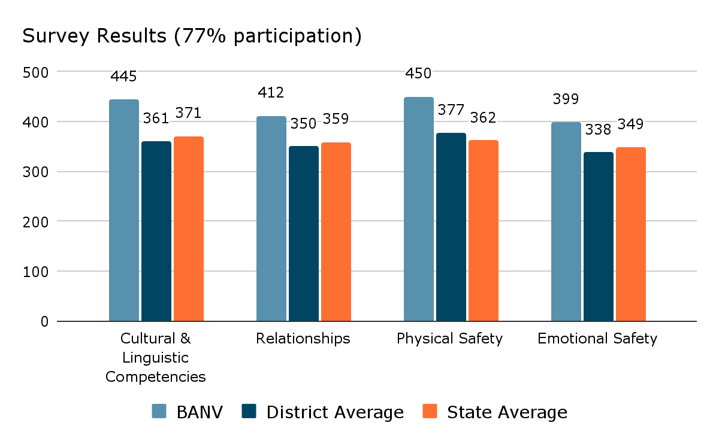
School Performance: Student NV-SCSEL Survey
Every year BANV performs significantly better than the state and district average.
“Relationships with students and adults are a strength at the school, and the system and organization for mentorship and the adult-to-student connection are a paragon of success in the educational environment.”
Cognia Accreditation Report, February 2022
Notes:
Because Beacon serves such a high need population, it’s crucial we maintain a positive learning environment. Many students enter with specific behavior challenges and most have never experienced academic success. Our student climate and culture results demonstrate our commitment to our mission.
The challenge we rise to is to provide our students with an engaging, kind and friendly environment that will support them emotionally and academically. For example, we currently have 3 LMSW and 1 LCSW and we have a vacancy for one more with just over 600 students.
How we build relationships and how it is safe.
About the survey: Administered by the NDE. A score of 401 or higher is most favorable, favorable is between 301-400 and below is least favorable.
Cultural & Linguistic Competencies: How students, their peers, and school staff demonstrate empathy, understanding and respect for different cultures and ethnic groups. In a diverse school such as Beacon, our staff knows that cultural differences may influence learning styles, communication and behavior. Cultural competency means that you are aware of your own cultural identity, understanding an understanding of differences and ability to learn and build on the varying cultural and community norms of students and their families.
Relationships: Students who have relationships at school and feel connected are more likely to succeed. Building positive relationships is a cornerstone of our program at BANV. We emphasize the importance of Maslow’s hierarchy of needs before addressing student academics. We say that we must Maslow before we Bloom (Bloom's taxonomy of human cognition).
Safety
-Physical: For students to learn, they need to feel safe. Physical safety is related to higher academic performance, fewer risky behaviors, and lower dropout rates. Visitors to both campuses comment on the quiet, organized and productive learning environment. Our school gives off a safe and caring “vibe” that permeates each building.
-Emotional: Refers to the range of experiences in which students feel open to express emotions, trust adults around them, exhibit confidence, and feels excited to try something new. BANV relys upon PBIS to ensure that feel safe, respected and are intentionally taught pro-social skills.
Social & Emotional: This score measures students perceptions of their own skills in the five main areas of social and emotional competency: self-awareness, social awareness, self-management, relationship skills and responsible decision making. Research and our anecdotal evidence shows that developing these skills improves attendance, behavior, grades and attitudes towards school.

Slide 9
School Performance: Student Survey
“I use G.R.I.T. everyday in school and out of it too. I come to school and work and don’t stop” ~ Projected Grad Date: Summer, 2026
“I don't feel stressed to rush to get work done. I can work at my own peace and take my time and actually learn about the lesson. I also love how I can ask for help. When I ask for help it is not like my old school where I still don't understand anything. My teachers at Beacon take their time to sit down next to me and help me understand.”
~ Projected Grad Date March, 2025
“This school is amazing and it really shows me what I am capable of. ”
~ Projected Grad Date: Summer, 2025
“Beacon helped me see that it's okay to need help because you can get the help you need when you are falling behind. The teachers are always available to sit with you and help understand your assignment”
~ Projected Grad Date: December, 2026
“I think I always try my best when I go to school and do my work there because I feel like I can calmly do my work in peace.”
~ Projected Grad Date: March, 2025
“I come to in person classes and I love the support that we have from the teachers! They help push us further to meet our goals, it's a very welcoming and comfortable environment.”
~ Grad Date: May, 2024
“I have a great experience in my classes because I can go at my own pace and finish my classes faster.”
~ Projected Grad Date: October, 2025
“Beacon Academy is more organized than other schools.”
~ Projected Grad Date: May, 2026
“I love my experience at Beacon. It’s better than any other school I've attended.”
~ Projected Grad Date: March, 2026
“This is a great school. They are really flexible and the teachers are very helpful.”
~ Projected Grad Date: December, 2024

Slide 10
Nevada Report Card
2015: Every Student Succeeds Act (ESSA) is reauthorized. States are required to create or revise accountability systems to ensure school performance metrics are reported consistently for all schools. These metrics are reported within the Nevada Report Card*.
BANV will always be a one star school within this framework.
Over 70% of our students enroll following a significant gap in their academic history. They haven’t acquired the same content knowledge as their peers, which reflects on standardized testing. They are not on track to graduate with their cohort.
11th graders take the ACT while lagging 1-2 years behind their peers in high school credits.
Over 60% of students within the cohort graduation data enroll during their senior year, while lagging 1-3 years behind their peers.
BANV students have exhausted all other options before enrolling.
*Alternative education schools are still required to be rated within the Nevada Report Card.

Slide 11
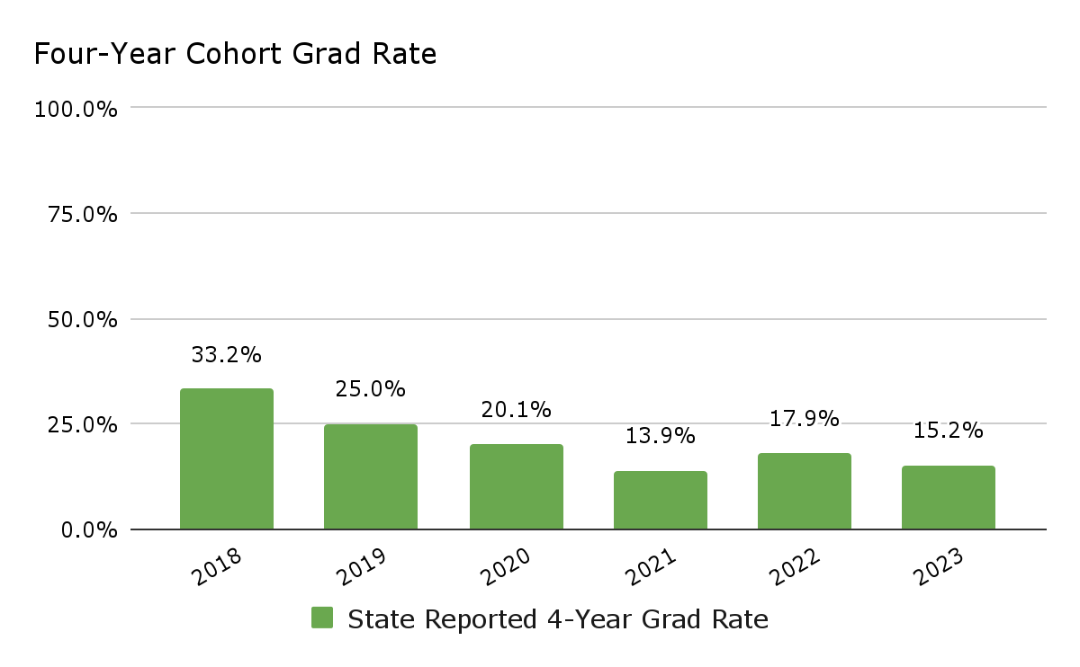
School Performance: Four Year Cohort
Notes:
Number of students within cohort data (grads):
2018: 271 (91) - 2019: 272 (68) - 2020: 239 (48) - 2021: 181 (25) - 2022: 246 (44)
Our students primarily enroll with us their 3rd or 4th year in HS and on average it takes them 2 years to graduate
2021 5 year cohort report 34% with 46% of students within the group still enrolled when the data with submitted

Slide 12
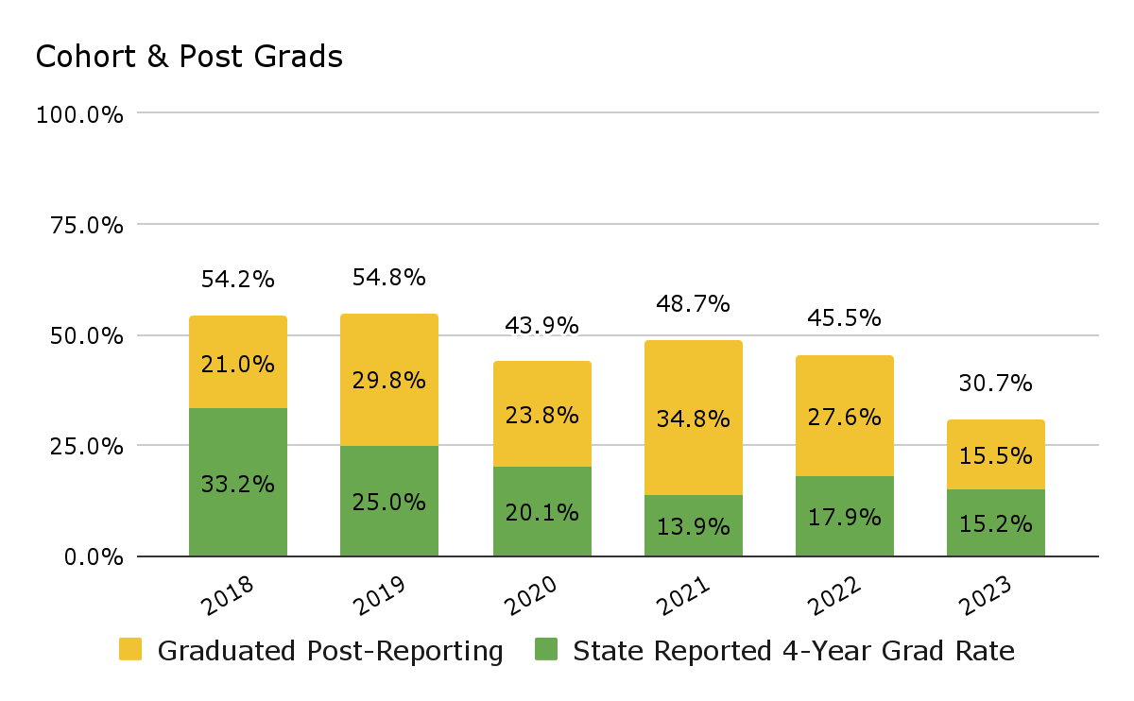
School Performance: Cohort and Post Grads

Slide 13
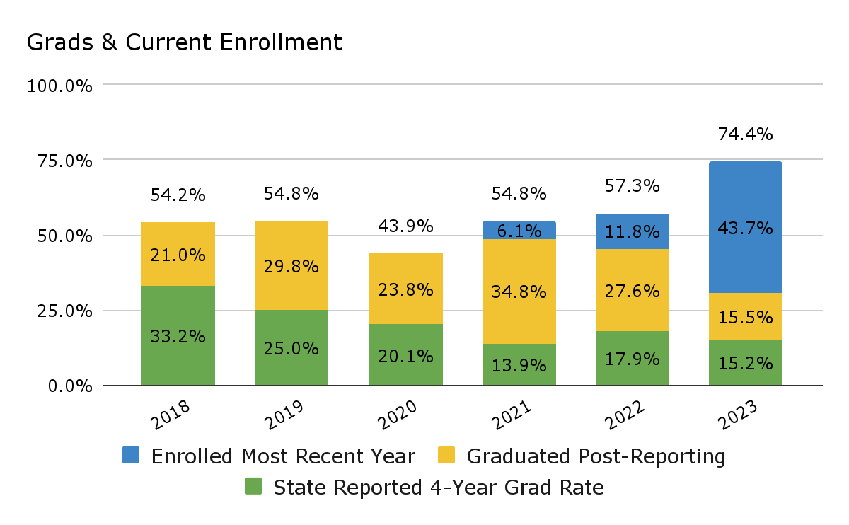
School Performance: Enrolled Beyond Reporting

Slide 14
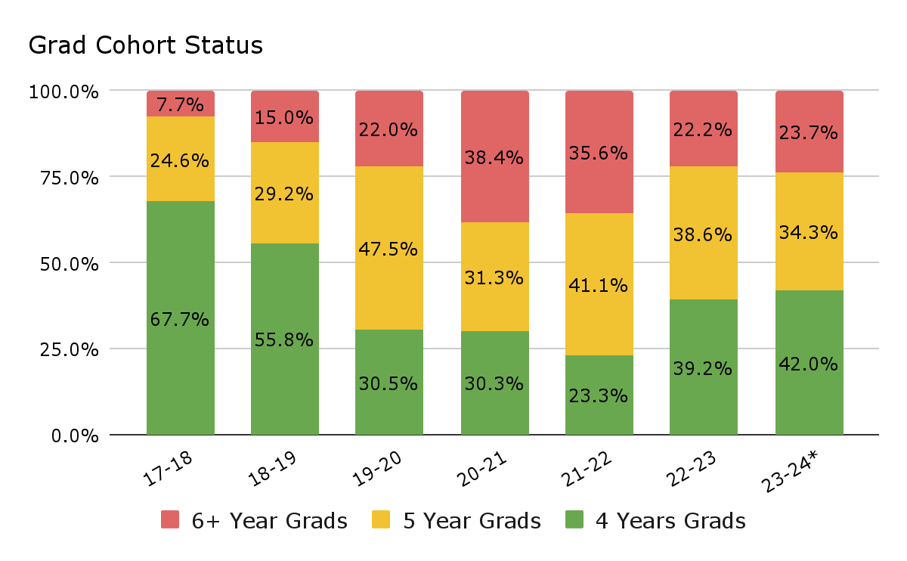
Historical Grads Per Academic Year by Cohort
 | Total Grads
17-18 | 130
18-19 | 120
19-20 | 118
20-21 | 99
21-22 | 90
22-23 | 153
23-24* | 207
*2024 cohort validation begins after the 24-25 count day; figure does not include summer grads

Slide 15
BANV’s Report Card
2015-2016: BANV applied to be included under the new alternative performance framework. The school developed an alternative education report card with the help of industry experts at Momentum Strategy & Research. These metrics are reported within a BANV-specific Alternative Performance Report Card.
This report card allowed a more nuanced analysis of student performance. It was developed prior to the development of NDE’s Alternative Performance Framework.
Data is validated by a 3rd party, Momentum Strategy & Research
Metrics in this report card include:
Meeting MAP growth norm benchmarks
Math and ELA ACT scores
Credit earning rates
Transition success
Graduation attainment
Chronic absenteeism
Student retention/persistence

Slide 16
BANV APF: Growth
Growth (30 percent) - Meeting MAP Growth
Data Element | Source | Actual Score | Assigned Rating | Included Students
Ave Percentile: Reading (15%) NWEA | NWEA | 41.9% | APPROACHES | Includes any student enrolled 91+ days with a pre and post test available.
Ave Percentile: Math (15%) NWEA | NWEA | 47% | APPROACHES
Notes:
In Nevada, alternative education schools are rated under NDE’s NSPF and APF. In addition, the BANV report card was developed through collaboration between Momentum Strategy & Research, Beacon and SPCSA staff. Alternative education schools utilize alternative measurements because conventional metrics do not measure the quality of their program.
The data measurements are a combination of metrics used on the NDE’s NSPF, APF as well as unique measurements that were chosen based upon the school’s mission to serve students that are at the highest risk of not graduating from high school.
We MAP test our students 3 times per year in order to obtain baseline data and growth throughout the year. The benchmarks in the report card for the rating are based upon research that indicates students that are behind in core credits in high school will show slower growth to meet grade level benchmarks. It is also indicative of our baseline data that demonstrates over half of our students have scores below grade level in math and reading.
Data reflects the percentage of students whose MAP growth meets or exceeds grade level projections.
By default students with two test scores were already enrolled 91+ days. No difference in results would be seen by including a broader group of students.

Slide 17
BANV APF: Status
Status (20 percent) - ACT, 2 or higher
Data Element | Source | Actual Score | Assigned Rating | Included Students
Math Pooled Average (10%) | APF/ACT | 27.3% | APPROACHES | Includes any students enrolled 30+ days, which varies from the NSPF range of 90+ days.
ELA Pooled Average (10%) | APF/ACT | 45.9% | ADEQUATE
Notes:
Data considerations: ACT is a graduation requirement in Nevada. A large portion of Beacon students are recovering academically after struggling in other academic environments. Many students are required to test at Beacon in order to graduate, but they were previously scheduled for testing multiple times in other schools and did not participate. Many of these students are not entering college and do not take the exam seriously.
These scores include all 11th and 12th grade students that took the ACT and were enrolled for 90+ days.
As a reminder, students that enroll at BANV their 11th grade year have 5 credits or less at the end of 10th grade. Students are severely core credit deficient in math and english.
Both calculations include more students than the NSPF, since the number of days enrolled differs substantially. These results are different than the APF because the cut score varies. The APF uses a cut score of 3, which is meant to demonstrate a student’s ability to earn a C in college level coursework. Our calculation uses a cut score of 2, which is meant to demonstrate grade level proficiency. In reality, ACT is not an appropriate measure to determine proficiency but it’s what the state decided to adopt.
Level 2 ELA 12+, Math 15+, Level 3 ELA 17+, Math 20+

Slide 18
BANV APF: College & Career Readiness
College and Career Readiness (40 percent)
Data Element | Source | Actual Score | Assigned Rating | Included Students
Credit Earning Rate (20%) | APF/IC | 76.8% | EXCEEDS | Includes all students
Transition Success (15%) | IC/Momentum | 87.5% | EXCEEDS | Includes students enrolled 91+ days
Graduation Attainment (5%) | APF/IC | 4.6 (out of 10) | ADEQUATE | Includes all students with non-neutral status codes
Notes:
Data considerations:
Credit earning rate is an average of the percentage of students passing their classes. This aligns to the APF calculation. Internally we track students core credit earning rate and the percentage of students that earn a C or higher in their classes.
Transition success measures students who maintain their enrollment at Beacon, graduate or are successfully transferred to another educational environment. This measure if different from most state metrics, since transferred students are removed from the figures. We focus upon keeping the student engaged until they reach their goal of graduating from high school.
Graduation attainment includes students who are retained as seniors, whereas traditional graduation results consider these students to be drop outs. The metric assigns a point value to graduates and retained seniors and then averages the scores. The point value for graduates is 10. The point value for retained seniors is 5. Beacon has a high number of non-graduates still enrolled.

Slide 19
BANV APF: Student Engagement
Student Engagement (10 percent)
Data Element | Source | Actual Score | Assigned Rating | Includes Students
Chronic Absenteeism (5%) | NSPF/IC | 44.9% | CRITICAL | Includes all students
Retention Rate (5%) | IC/Momentum | 70.4% | EXCEEDS | Includes students enrolled on the last day of school.
Notes:
Data considerations:
Chronic absenteeism is not a problem unique to BANV since spring of 2020. However, the metric is much different in an blended school and is a brick and mortar measure.
courses are self paced and students are able to recover from instructional gaps, it is not based upon seat time in a classroom
Our attending reporting approved by the NDE positive attendance to determine whether or not students submit work in all of their classes each week. Students who have a week gap for submitting in assignments one or more classes are considered truant for the week and this counts as 5 instructional days within this metric.
Chronic absenteeism rate in 20-21 was 59.7%, 42% 2018-2019
Retention rate refers to students who were enrolled on the last day of school for the 21-22 school year, were eligible to enroll the following year, and were enrolled on the 22-23 school year count day on October 3rd.

Slide 20
BANV APF: Report Card Results
2022-2023 Results
Category | Points Possible | Points Received
Growth | 30 | 11.25
Status | 20 | 10
College & Career Readiness | 40 | 32.9
Student Engagement | 10 | 4.4
Total | 100 | 58.5
Designation Ranges
Final School Designation | Total Points Received
Exceptional | 95.0-100.0
Exceeds | 75.0-94.9
Adequate | 50.0-74.9
Approaches | 25.0-49.9
Unsatisfactory | 5.0-24.9
Critical | 0.0-4.9
Notes:
Our overall rating on the report card is adequate. As you can see, the unique metrics used to evaluate an alternative education high school focus upon many areas. We have identified areas for improvement throughout these measures. The most important role for our staff this year is to re-engage students that have not attended in the past two years.
Our enrollment continues to increase as students and their families find Beacon, the only place that they can graduate from high school.

Slide 21
NDE Alternative Performance Framework (APF)
2017: The Nevada Department of Education launched tier Alternative Performance Framework (APF).
These metrics are reported within NDE’s APF Report Card.
Metrics in this report card include:
* Math and ELA ACT scores
* Credit earning rates
Science scores
* Graduation attainment
Four year graduation rate
Five year graduation rate
*Similar names as other report cards, but different calculation methods.
NDE’s APF results utilize a Continuum of Performance, which determines if school performance is Maintaining, Improving, or Declining.

Slide 22
NDE Alternative Performance Framework
2022-2023 NDE APF Results
Category | Result | Continuum of Performance
Credit Earning Rate | 76.7% | Maintaining
4-Year Cohort Grad Rate | 17.8% | Maintaining
5-Year Cohort Grad Rate | 36.1% | Maintaining
Attendance Rate | 85.9% | Maintaining
Chronic Absenteeism | 47.4% | Maintaining
Notes:
*Student engagement options were not included in the presentation, because they aren’t accurately reflected due to a data upload issue through NDE.*

Slide 23
Next Steps
Improve student attendance
Increase student’s earning a C or higher in core subjects
Increase the number of graduates each year
Purchase west campus facility
Increase School Based Mental Health Services
Provide direct mental health services to students and families
Social Work Board Approval - Clinical Intern Site
6 School Social Workers
2 School Psychologists
Currently Pending:
Medicaid Reimbursement for SPCSA for sponsored schools

Slide 24
Closing Slide and
Questions

