Slide 1
SPCSA Academic Performance Framework
June 28, 2019
Notes:
6/6 – refer

Slide 2
SPCSA Academic Performance Framework
NSPF/ Star Rating
60 pts
Geographical Comparison
25 pts
Diversity
15 pts
School Progress Measure
Nevada School Performance Framework - Star rating – 60 pts
Zoned school index score comparison – 15 pts
ELL enrollment – 5 pts
ELA - % Reduction on non-proficient students
FRL enrollment – 5 pts
Local district index score comparison – 10 pts
IEP enrollment – 5 pts
Math - % Reduction on non-proficient students
Bonus – 3 pts

Slide 3
Academic Performance Framework: Areas of Focus
 | Indicator | Measure
1 | Nevada School Performance Framework – Star Ratings | Star Rating Index Score
2 | Geographical Comparison | Zoned School and Local District Index Score Comparison
3 | Diversity | Special Population Enrollment
4 | School Progress | Reduction Rate on Non-proficient Students

Slide 4
Stakeholder engagement process
Academic Performance Framework Development
Listening Sessions
February 1, 2019
February 4, 2019
February 7, 2019
Listening Sessions
Working Group Meetings
Academic Performance Working Group Meetings
March 5, 2019
April 2, 2019
April 30, 2019
May 14, 2019
June 20, 2019
Board Updates on progress
March 8, 2019
April 19, 2019
May 31, 2019
Board Meeting Updates
Email distribution and final call for revisions and comments
June 18, 2019
Final Comments
Board Meeting presentation for possible action
June 28, 2019

Slide 5
Academic Performance Framework: Earning Measure and Indicator Points
Notes:
Star rating yerine index score koy

Slide 6
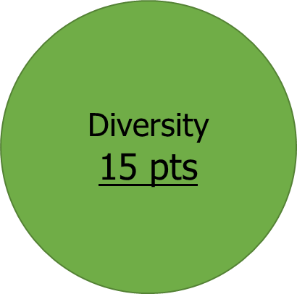
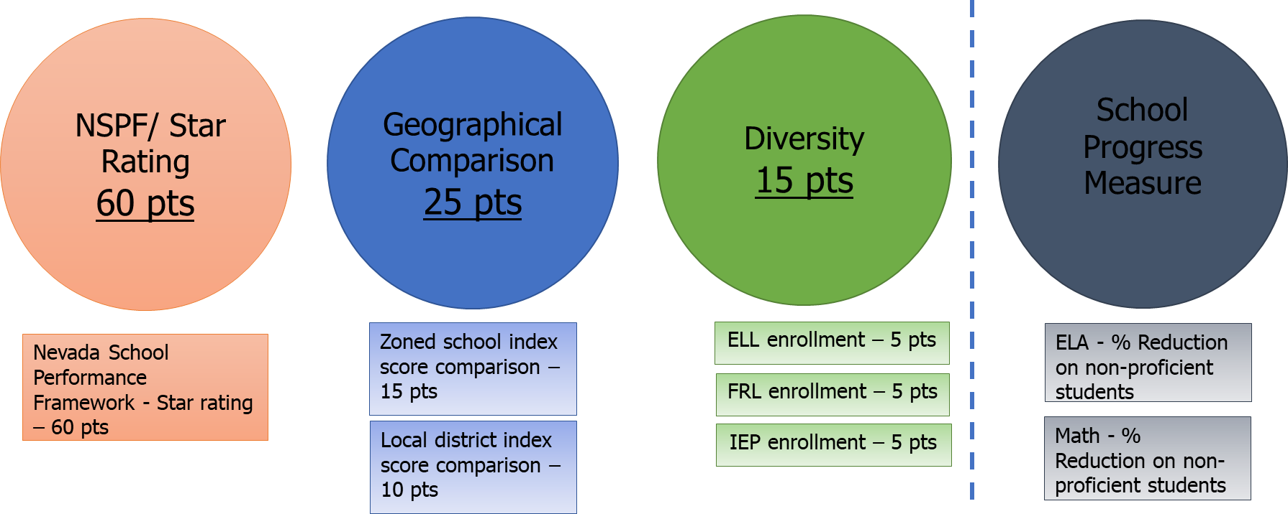
Academic Performance Framework: Implementation
FRL enrollment – 5 pts
If the school’s Free & Reduced Lunch enrollment is greater than 60%

Slide 7
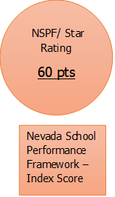
Academic Performance Framework: Earning Measure and Indicator Points
Index scores generate NSPF Star Ratings.
The total index score from NSPF results will incorporate SPCSA Academic Performance Framework.
ABC Elementary School index score is 85. The calculation would be 85 multiplied by 0.6, giving the school 51 points (85*0.6= 51).

Slide 8
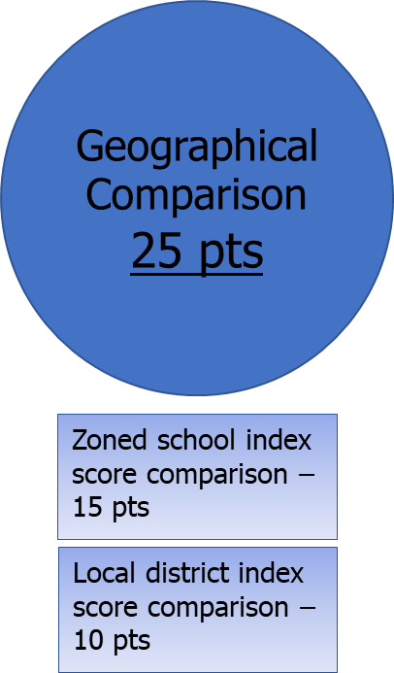
Academic Performance Framework: Earning Measure and Indicator Points
Zoned school index score and district index score will be compared with SPCSA schools.
If the SPCSA school receives a 5-Star rating from NSPF, it will automatically be given 25 points.
If the SPCSA school receives a 4-Star rating from NSPF, it will automatically earn 15 points and may qualify for additional points depending on comparison results.

Slide 9
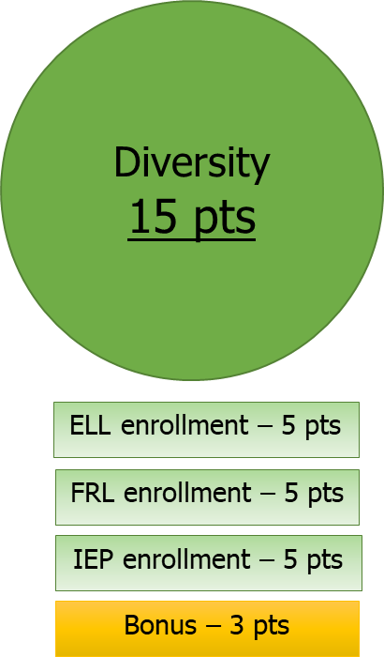
Academic Performance Framework: Earning Measure and Indicator Points
Student enrollment on special populations (English Language Learners, Free and Reduced Lunch and Individualized Education Plan) will be compared with their district.
Statewide schools will use a statewide comparison for special populations enrollment.
Schools showing an annual increase 25% or more in ELL, FRL or IEP categories will receive three bonus points.

Slide 10
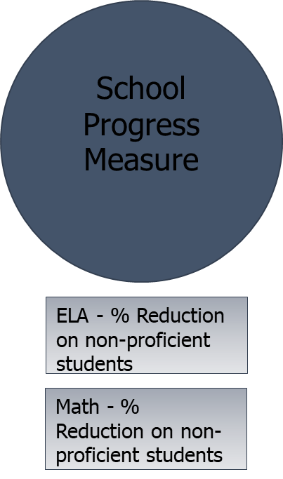
Academic Performance Framework: Earning Measure and Indicator Points
Non-proficient students’ performance on the mandated state assessment.
Current and prior year state mandated assessment results will be used.
Whether the school demonstrated a reduction in non-proficiency rates in ELA and Math.
This indicator is informational only, there are no points attached to this.

Slide 11
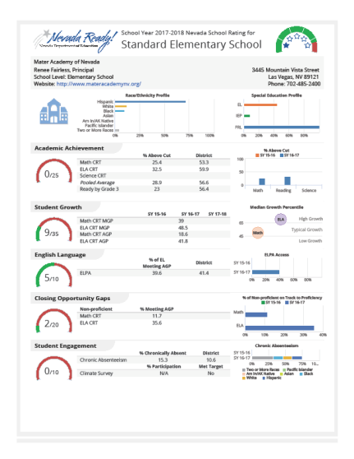
Academic Performance Framework: School Designation Activity
Index Score 85
NSPF 85*0.6 = 51
Zoned school comparison = 15
Local district comparison = 10
FRL points = 4
ELL points = 3
IEP points = 4
TOTAL POINTS : 87
ABC ELEMENTARY SCHOOL
Free & Reduced Lunch 55%
English Language Learners 9%
Students with Disabilities (IEP) 10%

Slide 12
Academic Performance Framework: School Designation Activity
Index Score 70 points
Zoned School Index 40
Local District Index 50
NSPF 70*0.6 = 42
Zoned school comparison = 10
Local district comparison = 3
FRL points = 5
ELL points = 2
IEP points = 3
TOTAL POINTS : 65
DEF ELEMENTARY SCHOOL
Free & Reduced Lunch 40%
English Language Learners 7%
Students with Disabilities (IEP) 5%

Slide 13
Academic Performance Framework: Designation
Exceeds Standard | Exceeds Standard | >= 80
Meets Standard | Meets Standard | >=50 and < 80
Does Not Meet Standard | Does Not Meet Standard | >=20 and < 50
Far Below Standard | Far Below Standard | > 20
ABC ELEMENTARY SCHOOL
TOTAL POINTS : 87
DEF ELEMENTARY SCHOOL
TOTAL POINTS : 65

Slide 14
Academic Performance Framework:
Data Sources
Nevada Department of Education student enrollment counts (Validation Day File - October 1, 2018).
Nevada School Performance Framework (NSPF) Star Ratings (September 15, 2019).
Current and prior year State mandated assessment results (SBAC and ACT).

Slide 15
Special thanks to these individuals for their contributions to the Academic Performance Framework

Slide 16
Summary: Academic Performance Framework
The SPCSA framework
Sets forth clear academic performance expectations
Aligns with the NSPF so as to promote consistency
Will inform high-stakes decisions and possible interventions

Slide 17
Questions

