Slide 1
Update Concerning the Status of COVID-19 in Nevada
Kyra Morgan, MS, State Biostatistician
Julia Peek, MHA, CPM, Deputy Administrator of Community Health Services

Slide 2
COVID-19 By The Numbers

Slide 3
COVID-19 By The Numbers
Nevada has experienced a sustained decline in new cases being diagnosed since July 13th.
We experienced the highest number of daily deaths on 7/29 and 8/5 – 20 deaths on each of those days.

Slide 4
COVID-19 Testing Turnaround
For specimens collected since August 1st, it has taken approximately 3 days after specimen collection for results to be reported.

Slide 5
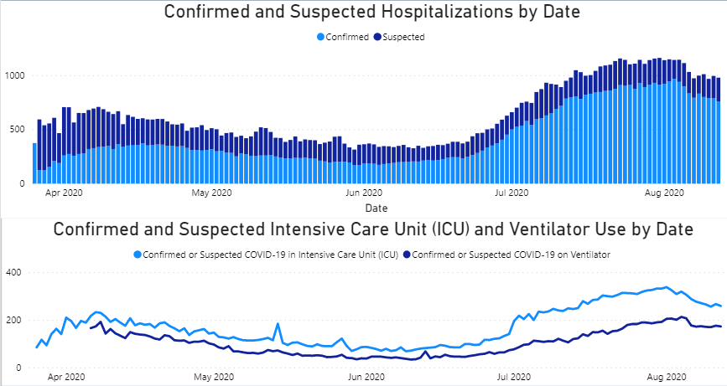
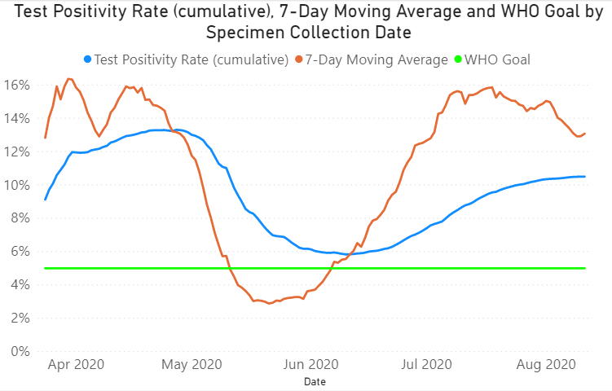
COVID-19 By The Numbers
Hospitalizations were following an increasing trend until 8/03 and have since been decreasing for the past 9 days.
The cumulative test positivity rate was following an increasing trend until 08/01 and has been stabilizing for the past 12 days, with only very slow increases.

Slide 6
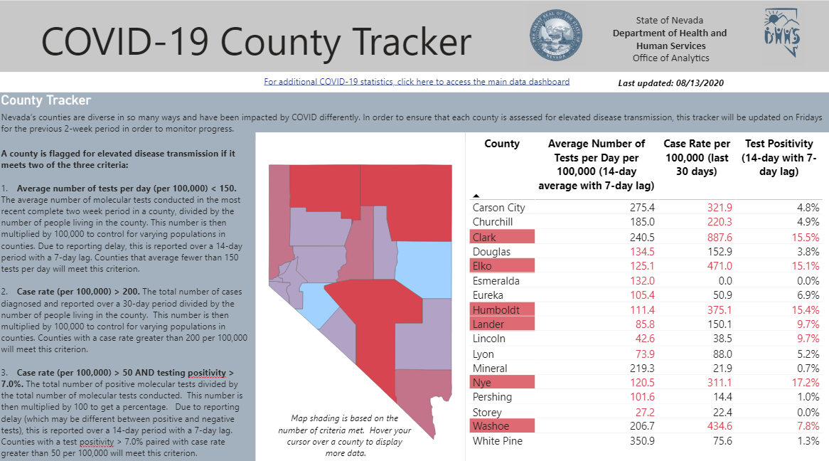
COVID-19 County Tracker

Slide 7
COVID-19 County Tracker
County Tracker criteria over time.
Carson City and Lincoln Counties are no longer flagged for elevated disease transmission.

Slide 8
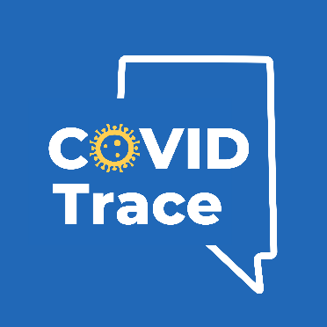
Case Investigation and Contact Tracing
Goals:
Every Nevadan who tests positive for COVID-19 will be contacted by a contact tracer within 24 hours of that confirmatory lab report being received by the health authority.
Within 24 hours of identifying a close contact of a case, those individuals will be communicated with by a contact tracer.
Based on Based on the NACCHO estimate for effective COVID response, Nevada should have up to 948 full-time staff to support the case and contact investigations. This does not consider efficiencies found through automation of process and digital solutions.
DPBH is working with Google and Apple to deploy COVID Trace, a proximity-based app to support the more traditional contact tracing services. Deployment is planned for mid-August. There will be a “soft launch” with media partners to allow them to see the system before the official launch.
Themes related to case investigation and contact tracing:
Social gatherings outside of businesses
Familial/household exposure
Exposure at businesses/community exposure
Hotel/resort
Food establishments
Healthcare settings
COVID-19 Cases Identified Through Contact Tracing Efforts from January 1, 2020 to August 11, 2020
Vendor/Agency | Estimated FTEs (call center staff, contact tracers, management, epidemiologists, disease investigators, administrative support, statisticians, etc.)
Deloitte | 250
CAAA | 200
UNLV (supports Clark County) | 100
Great Basin College (supports Elko County, Lander County, and Eureka County) | 4
UNR (supports Washoe County, Carson City, Lyon County, Storey County, and Douglas County) | 90
State/Local Health Depts | 200
Total Estimated Contract Staffing | 844
County | Positive Contacts Identified Through Case Investigation
Carson | 6
Churchill | 31
Clark | 8,325
Douglas | 0
Elko | 173
Eureka | 1
Humboldt | 34
Lander | 24
Lincoln | 0
Lyon | 0
Mineral | 4
Nye | 30
Pershing | 1
Storey | 0
Washoe | 554
White Pine | 4
Total | 9,187 (represents 15.8% of total cases reported to date)
Please note Esmeralda County is omitted from this table, as they have had no reported COVID-19 cases to date. Data may change as cases still open for investigation are subject to changes in identification process types.

Slide 9
Discussion

