Slide 1
SPCSA Organizational Performance Framework Recommendations
November 6, 2020

Slide 2
Presentation Objectives
1 | Briefly reiterate goals of the Organizational Framework
2 | Present results and recommendation for SPCSA Schools in 2019 – 2020

Slide 3
Organizational Framework Principles
1 | Enable SPCSA to fulfill its mission as authorizer and regulator
2 | Fulfill NRS 388A.273 requirements for performance indicators, measures and metrics for the organization category
3 | Fulfill public school obligations, provide transparent reporting
4 | Convey SPCSA expectations of charter schools
5 | Streamline work for staff and schools

Slide 4
What does each framework measure?
Academic
Financial
Organizational
Is the educational program a success?
Is the school financially viable?
Is the organization effective and well run?
Source: NACSA Core Performance Framework and Guidance

Slide 5
Organizational Framework: Areas of Focus
 | Category/Indicator | How is this evaluated by the Authorizer? | Points
1 | Education Program | Adherence to the material terms of its program and the responsibility to serve all students | 20
2 | Financial Management and Oversight | Audit completion, results and audit findings | 20
3 | Governance and Reporting | Board compliance with governance-related laws | 20
4 | Students and Employees | Adherence to state and federal laws and regulations | 20
5 | School Environment | Compliance with facility, transportation, food and health service requirements | 20

Slide 6
Ratings
Meets Standard Rating
Schools earning this rating are performing well and are generally compliant
The targets for this rating category set the minimum expectations for charter school performance
Does Not Meet Standards
Schools in this rating category failed to meet minimum expectations
At a minimum, they should be subject to closer monitoring, and their status for renewal is in question
Notes:
6/12 focus on this.
Meets Standard:
The “Meets Standard” rating is defined by the threshold of success for the measure, or the target the school is expected to meet. In the Organizational Framework, this rating provides the detailed metrics against which the charter school is judged. If the school meets the target, then the authorizer does not need to follow up with the school or require corrective action. Schools do not meet the standard if failures are material in nature, meaning they are relevant to the authorizer’s accountability decisions.
Does Not Meet Standard:
The “Does Not Meet Standard” rating remains consistent for each measure in the Organizational Framework and reads:
“ The school has failed to implement the program in the manner described above; the failure(s) were material, but the board has instituted remedies that have resulted in compliance or prompt and sufficient movement toward compliance to the satisfaction of the authorizer.”
This means that the school has materially failed to meet the target at any point during the evaluation period; however, the failure(s) were not significant to the viability of the school and the board has either brought the school into compliance or has made sufficient progress toward compliance. Schools with a number of
“Does Not Meet Standard” designations may be considered for non-renewal.

Slide 7
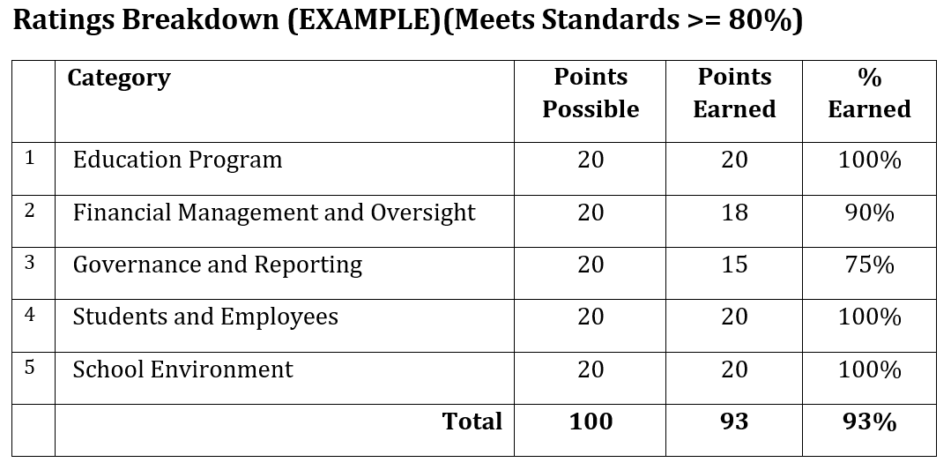
Scoring: How Points are Awarded (Example)

Slide 8
2019 – 2020 SPCSA Results
 | Category/Indicator | Average Score | Available Points
1 | Education Program | 19.8 | 20
2 | Financial Management and Oversight | 20 | 20
3 | Governance and Reporting | 19.9 | 20
4 | Students and Employees | 20 | 20
5 | School Environment | 20 | 20
All schools earned at least 80 points out of a possible 100.
No schools earned below 97 points out of a possible 100.
Former ASD schools will be formally evaluated beginning in the current academic year (20-21)

Slide 9
Interventions
Notice of Concern
Evidence of weak organizational performance
Notice of Breach
Continued evidence of weak organizational performance
Failure to make progress to remedy failures or concerns
Notice of Intent to Revoke
Serious violations of law, regulation or the charter
Patterns of failure to comply
Repeated or material failures
“Occasionally, the routine Performance Framework process will result in adverse findings. Charter schools may fall out of compliance on important legal or contractual requirements. Academic standards may not be met. Financial sustainability may become an issue. When these situations occur, the Authority may respond in a number of ways.”
Pg 5 Charter School Performance Framework

Slide 10
Staff Recommendation
Accept the 2019 – 2020 Organizational Framework Results as presented, and delegate to SPCSA staff the authority to provide final results to governing boards of each charter in the coming weeks.

