Slide 1
SPCSA Performance Framework Overview
August 15, 2020
Notes:
6/6 – refer

Slide 2
Goals for Today
To reiterate why Performance Frameworks are critical to the work of a charter school authorizer
To understand the basic components of each SPCSA Framework
Academic
Financial
Organizational
To identify when results for each framework will be presented to the Authority.

Slide 3
Why are Performance Frameworks Important?
1 | Enable the SPCSA to fulfill its mission as an authorizer and regulator
2 | Fulfill NRS 388A.273 requirements for performance indicators, measures and metrics
3 | Fulfill public school obligations and provide transparent reporting
4 | Convey SPCSA expectations of charter schools
5 | Streamline work for the SPCSA and sponsored schools

Slide 4
What is a Performance Framework?
Accountability
Autonomy
Document that sets forth agreed upon expectations of performance and compliance
Established in the charter agreement
Basis for school evaluations, ongoing monitoring and intervention that informs high-stakes decisions by an authorizer

Slide 5
Performance Frameworks Tell Us
Academic
Financial
Organizational
Is the educational program a success?
Is the school financially viable?
Is the organization effective, compliant and well-run?
Source: NACSA Core Performance Framework and Guidance

Slide 6
Academic Performance Framework: Areas of Focus
 | Indicator | Measure
1 | Nevada School Performance Framework – Star Ratings | Star Rating Index Score
2 | Geographical Comparison | Zoned School and Local District Index Score Comparison
3 | Diversity | Special Population Enrollment
4 | School Progress | Reduction Rate on Non-proficient Students

Slide 7
SPCSA Academic Performance Framework
NSPF/ Star Rating
60 pts
Geographical Comparison
25 pts
Diversity
15 pts
School Progress Measure
Nevada School Performance Framework - Star rating – 60 pts
Zoned school index score comparison – 15 pts
ELL enrollment – 5 pts
ELA - % Reduction on non-proficient students
FRL enrollment – 5 pts
Local district index score comparison – 10 pts
IEP enrollment – 5 pts
Math - % Reduction on non-proficient students
Bonus – 3 pts
Source: SPCSA Academic Framework Technical Guide

Slide 8
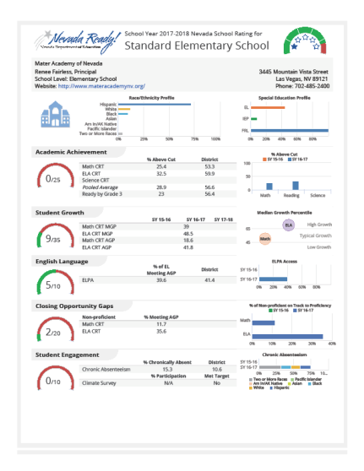
Academic Performance Framework: School Designation Activity
Index Score 85 (5-star)
NSPF 85*0.6 = 51
Zoned school comparison = 15
Local district comparison = 10
FRL points = 4
ELL points = 3
IEP points = 4
TOTAL POINTS : 87
ABC ELEMENTARY SCHOOL
Free & Reduced Lunch 55%
English Language Learners 9%
Students with Disabilities (IEP) 10%

Slide 9
Academic Performance Framework: Designation
Exceeds Standard | Exceeds Standard | >= 80
Meets Standard | Meets Standard | >=50 and < 80
Does Not Meet Standard | Does Not Meet Standard | >=20 and < 50
Far Below Standard | Far Below Standard | > 20
ABC ELEMENTARY SCHOOL
TOTAL POINTS : 87

Slide 10
Academic Performance Framework:
Data Sources
Nevada Department of Education student enrollment counts (Validation Day File - October 1, 2019).
Nevada School Performance Framework (NSPF) Star Ratings (September 15, 2019).
Current and prior year State mandated assessment results (SBAC and ACT).

Slide 11
Questions

Slide 12
Financial Performance Framework: Areas of Focus
 | Indicator | Measure
1 | Near Term Measures | Current Ratio Unrestricted Days Cash-on-Hand Enrollment Forecast Accuracy Debt Default
2 | Sustainability Measures | Total Margin Debt to Asset Ratio Cash Flow Debt Service Coverage Ratio
Source: SPCSA Financial Framework Technical Guide

Slide 13
Why are these measures important?
Based on best practices nationally
Confirmed through stakeholder engagement that these are the most critical calculations that sponsored schools monitor
Respect charter autonomy in spending and budgeting decisions
Allow the SPCSA to confirm financial health in the short and long-term

Slide 14
Financial Performance Framework: Designation
Three Ratings for Each Measure (Near Term or Sustainability)
Meets Standard (MS)
Does Not Meet Standard (DNMS)
Falls Far Below Standard (FFBS)
Good Standing | Less than two DNMS ratings and no FFBS ratings
Possible Intervention | Three or more DNMS ratings and/or at least one FFBS rating
Continued Intervention | Continued failure to meet Good Standing requirements in multiple, consecutive years

Slide 15
Questions

Slide 16
Organizational Framework: Areas of Focus
 | Category/Indicator | How is this evaluated by the SPCSA?
1 | Education Program | Adherence to the material terms of its proposed program
2 | Financial Management and Oversight | Audit results and audit findings
3 | Governance and Reporting | Board compliance with governance-related laws
4 | Students and Employees | Adherence to state and federal laws and regulations
5 | School Environment | Compliance with facility, transportation, food and health service requirements
Schools can earn up to 20 points within each category for a total of 100 each year.

Slide 17
Balancing Autonomy and Accountability
1 | Authorizers generally focus on the ends (outputs); schools choose the means (inputs)
2 | Organizational Performance Framework abuts school autonomy closer than other two framework due to compliance focus
3 | Organizational Performance Framework is limited to processes mandated by laws, regulations or the contract

Slide 18
How are Points Awarded?

Slide 19
Organizational Performance Framework: Designation
Meets Standard | >= 80 points
Does Not Meet Standard | < 80 points

Slide 20
Questions

Slide 21
Reporting Timelines
Academic
Draft: Aug/Sept
Organizational
Draft: Dec/Jan
Financial
Draft: Aug/Sept
Recommendations: Oct/Nov
Recommendations: Oct/Nov
Recommendations: Feb

