Slide 1
Dr. Chris McBride
Superintendent
Nevada Connections Academy

Slide 2
Dr. Chris McBride
NCA Superintendent
Misty Vaughan Allen
Nevada’s Office of Suicide Prevention Coordinator
Named one of Time Magazine’s
“50 most influential people in health care”
Mollie Marti
CEO, National Resilience Institute
Nevada Connections Academy
Christine Dzarnoski – Elementary School Assistant Principal
Victoria Neer – High School Support Specialist; certified Ruby Payne trainer; Trauma-Informed Instructor
Nevada Connections Family
Jessie Berry, NCA Graduate
Veronica Berry, Learning Coach and Mother
Agenda for NCA’s Informational Presentation on Social-Emotional Learning

Slide 3
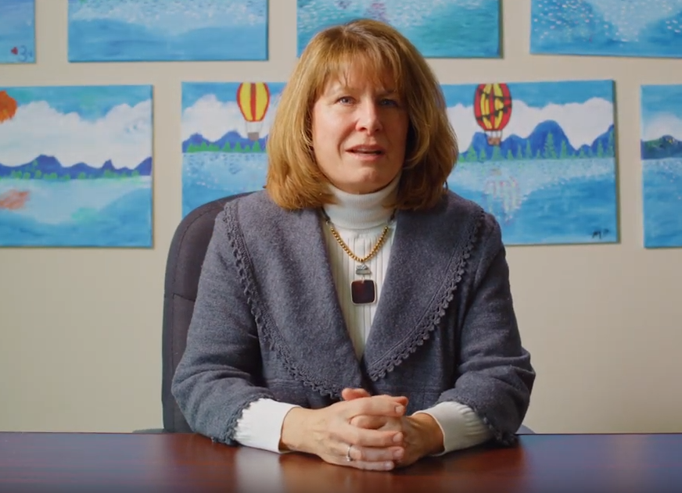
Curriculum and Innovative Learning Technology
National Increase in Teen Suicide is Alarming
Rate Increased 56% from 2007 to 2017 according to a CDC report.
“Interventions should include teaching all kids important social and emotional skills.”
Nevada has the 11th highest suicide rate in the country.
Nevada’s Department of Education recognizes the importance of Social & Emotional Learning (SEL).
"SEL competencies are critically important for the long-term success of all students in today’s economy.”
Social-emotional and academic development go hand-in-hand.
Research has shown that specific social-emotional competencies—such as self-management and growth mindset – are linked to academic and behavioral outcomes in school as well as health, wealth, and well-being outcomes throughout life.
Misty Vaughan Allen
Nevada’s Office of Suicide Prevention Coordinator
2018 Time Magazine’s
“50 most influential people
in health care”

Slide 4
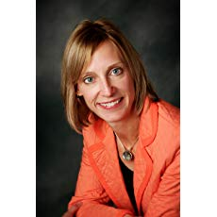
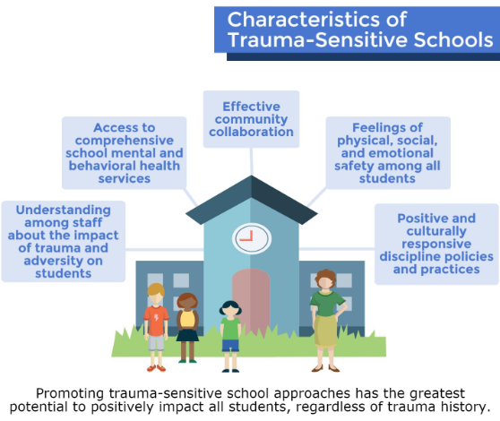
Social and emotional learning (SEL) is the process through which individuals acquire and effectively apply the knowledge, attitudes, and skills necessary to understand & manage emotions, set & achieve positive goals, feel & show empathy for others, establish & maintain positive relationships, and make responsible decisions.
Mollie Marti, PhD, JD
National Resilience Institute, CEO
Notes:
https://molliemarti.com/2017/10/creating-trauma-sensitive-schools/

Slide 5
NEVADA
CONNECTIONS
ACADEMY
CHRISTINE DZARNOSKI
NCA Elementary Assistant Principal
NCA students performed higher than the Charter District across every measure, at every grade band, in the Nevada School Climate/Social Emotional Learning Survey (NV-SCSEL).
VICTORIA NEER
NCA High School Support Specialist,
Certified Ruby Payne Instructor,
Trauma-Informed Instructor

Slide 6
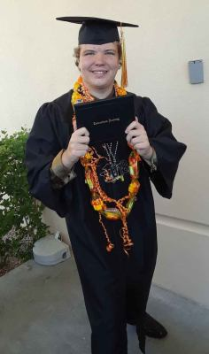
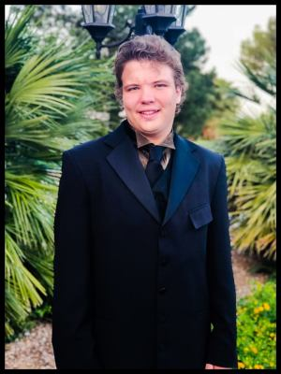
Nevada Connections Academy Family
Jessie Berry, NCA Graduate
Veronica Berry, Learning Coach and Mother

Slide 7
Questions?

