Slide 1
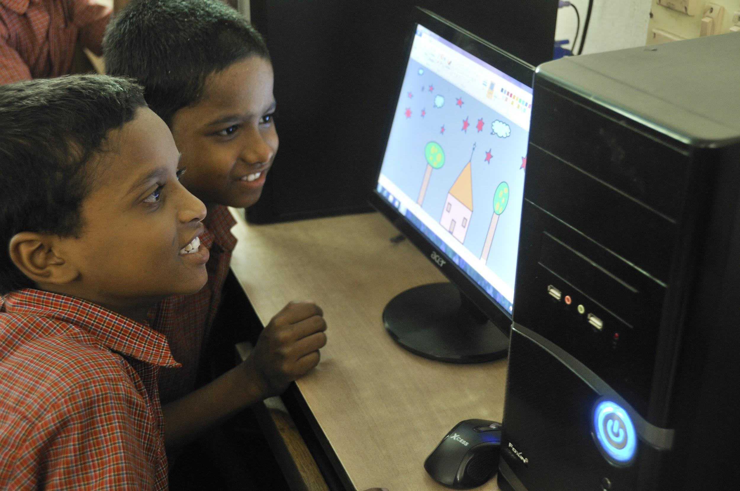
Schools with Mobile Populations: What does research say & its impact on Nevada Connections Academy?
Matthew Wicks
Director of School Accountability
Pearson Online & Blended Learning
Image placeholder

Slide 2
Connections Academy Online Schools
Connections Academy virtual schools provide a full-time online education to students in grades K-12 across the United States.
The online school program for these schools is provided by Pearson’s Online & Blended Learning K–12 group (also known as Connections Education which was founded in 2001).

Slide 3
CRITICAL MISSING INFORMATION:
STUDENT MOBILITY & IMPACT ON LEARNING
What we know:
Families with enrolled students express satisfaction with Connections Academy schools, however, general awareness and understanding about how virtual school works, who attends and why, remains riddled with misinformation and misperception.
Additionally, questions around student performance persist; existing research studies paint an incomplete picture of achievement.
Critical ingredient missing from existing research - mobility.
As such, Pearson set out to examine Connections Academy virtual schools; conducting research to explore the types of students who attend virtual school and their performance.

Slide 4
Mobility and the Efficacy Studies
Knowing that virtual school students are extremely mobile, the efficacy studies were designed, in part, to understand the drivers of mobility and its impact on performance.
What is mobility?
“In K-12 education, student mobility... can include any time a student changes schools for reasons other than grade promotion, but in general it refers to students changing schools during a school year.”
(Education Week, August 2016)
How is it defined and measured?
Measures differ across states with some states having no agreed upon measure
At Pearson Online & Blended Learning, number of prior schools attended
There are other ways as well that can and are used in different contexts (e.g. late enrollers, number of new students, during school year withdrawals, etc.)
Note. Mobility was measured using the most appropriate metric for each efficacy study (Number of prior schools was used in Phase One, and state definitions were used for Phase Two).

Slide 5
Background: Industry Research Findings - Impact of Mobility on Student Performance
The more often students moved, the lower they scored on both the state standardized math test and on teacher observations of the students’ critical thinking.
Even one non-promotional school move both reduced elementary school achievement in reading and math and increased high school dropout rates.
Most pronounced effects for students who made three or more moves.
Causes and consequences are varied and complex and so recommendations for addressing the issues must be adaptable and applicable to students’ unique circumstances.
Rumberger, Russell W. (2015). Student Mobility: Causes, Consequences, and Solutions. Boulder, CO: National Education Policy Center. Retrieved 10/16/17 from http://nepc.colorado.edu/publication/student-mobility.

Slide 6
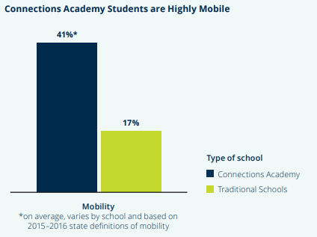
Considering Mobility
Of particular note, virtual school students are extremely mobile (and come to Connections with this characteristic); more than double that of traditional schools.
Student Mobility Twice State Average
53.4 (NCA) v. 23
Unlike existing research on virtual school, this research incorporates student mobility and explores the performance of the unique student body at Connections Academy.
Notes:
This is based on the efficacy study definition of mobility). See asterisk in the chart.

Slide 7
Current Efficacy Research
Study 1: Student Profiles
Study 2: School Comparison

Slide 8
Efficacy Research
Research Questions
What are key characteristics of students who enroll at Connections Academy schools, and in what patterns do we see characteristics or profiles “cluster” together? (Study 1)
How do students who attend Connections Academy schools perform in comparison to brick and mortar schools and non-charter virtual schools with similar characteristics within the same state? (Study 2)
Notes:
The project aimed first to determine what types of students are most likely to seek out Connections Academy schools. Essentially -- what are the characteristics that are driving that high mobility? And then, after accounting for those specific factors, determine if Connections Academy schools can serve these students as well or better than other public school options.

Slide 9
Study 1: Cluster Analysis Variables
Students were grouped into “clusters” or profiles based on the following student characteristics and performance outcomes.
SPED
Gender
Ethnicity
ELL Status
FARMS Eligibility
Type of Prior School
Withdrawal Status 15/16
Withdrawal Status 16/17
Enrollment Category 15/16
Consecutive Years Enrolled
Returned 16/17 Year
Mobility (# prior schools attended)
Reason for attending Connections Academy
State Reading Proficiency Level
State Math Reading Proficiency Level
ELA Course Average
Math Course Average
End of Course Survey Average

Slide 10
Study 1 Results: Clusters identified in student profile study
Student Profile | # Students in the profile | Reason(s) for Enrolling in a Connections Academy | % of Students new or returning | % enrolling late or on time | % of mobile students (# prior schools at initial enrollment)
1. Advanced students | 3,693 8% | Student is academically advanced | Equally new late and returning | Equally on time and late | 48%
2. Health problems | 5,224 11% | Student has physical or mental health problems | 67% new students | 54% late | 52%
3. New, bullied students | 6,164 13% | Student is experiencing bullying | 100% new students | 65% late | 60%
4. New, enrolled because struggling academically | 5,348 11% | Struggling academically | 100% new students | 64% late | 58%
5. New, enrolled for greater flexibility/virtual school choice | 14,812 31% | Vague reasons (Flexibility and dissatisfaction with local school) | 100% new students | Equally late and on time | 48%
6. Returning, enrolled for greater flexibility/virtual school choice | 7,491 16% | Vague reasons (Flexibility and dissatisfaction with local school) | 100% returning (2 to 3 years) | 93% on time | 35%
7. Returning, originally enrolled with various challenges | 4,981 11% | 50% bullied, 66% struggling academically, 16% health problems | 100% returning (2 to 3 years) | 90% on time | 58%

Slide 11
Study 1 Results
Connections Academy schools serve highly mobile students with complex needs known to impact academic performance. These students’ needs include, among others, health concerns, bullying and safety, looking to be challenged, trying to catch up, and flexible scheduling.
These characteristics create a unique student population that differs from traditional brick- and-mortar schools.

Slide 12
Study 2: School Comparison Study
How do students who attend Connections Academy schools perform in comparison to brick and mortar schools and non-charter virtual schools with similar characteristics within the same state?
Method: An exploratory study that directly compared achievement at a Connections Academy school to a similar brick and mortar school and a non-charter virtual school within the same state.
Sites were compared at grades 3-8 for Reading and Mathematics
All analyses were based on publicly available data.

Slide 13
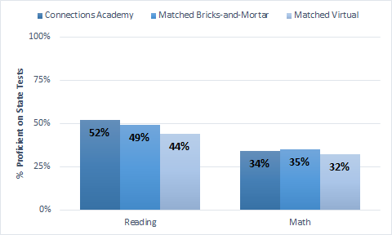
Study 2: Results
Only statistical difference: Connections Academy schools scored higher than matched virtual schools
No significant differences
Conclusion:
The results provide evidence that Connections Academy students can receive the same quality of education as that offered at their local public school, while simultaneously taking advantage of the benefits offered to them by virtual schools; and that students may be better positioned in Connections Academy schools than other virtual schools

Slide 14
Phase Two: School Comparison Study Results
Based on the SRI and PWC review, Pearson is able to make the following comparative statements about the efficacy of Connections Academy schools:
No statistical difference in percentage scoring proficient in math and reading between student cohorts in Connections Academy schools and cohorts in brick-and-mortar schools that were matched on prior achievement, and after adjusting for district-mean student mobility and school-mean student Socioeconomic Status (SES) and other demographic factors.
Student cohorts in Connections Academy schools statistically outperformed (by 7.9 percentage points) cohorts in other virtual schools (matched on prior achievement) in terms of the percentage scoring proficient in reading on state assessments.
No statistical difference in percentage scoring proficient in math between student cohorts in Connections Academy schools and cohorts in other virtual schools that were matched on prior achievement.

Slide 15
What does this mean for Nevada Connections students?

Slide 16
What About Other Accountability Metrics
The research established two key facts:
Connections Academy schools have incredibly mobile populations.
When you take mobility into account, Connections Academy schools perform equivalent to other schools on state assessments.
However, the Nevada State Performance Framework contains several accountability metrics beyond proficiency on state assessments. What are the implications of the research on these other metrics?

Slide 17
Growth, Graduation Rate, Attendance,
& College and Career Readiness
Growth makes up the largest part of the Nevada framework for elementary and middle school, especially when you consider Closing the Gap is another type of growth metric. However, the Student Growth Percentile system only takes previous performance into account, not mobility. Since mobility predicts a short-term decrease in academic performance, then highly mobile schools will likely perform poorly on the growth indicator.
Graduation rate is a metric that reflects 4-years worth of student performance. In a highly mobile school, the graduation cohort ends up reflecting a significant number of students that have only spent a portion of their high school years at the school that is being held accountable. It isn’t an accurate reflection of the performance of highly mobile schools.
A highly mobile school will have many more students coming and going during the school year. It is much easier to be considered chronically absent when the days of enrollment are for a shorter time period. The change this past year to require students to be enrolled for at least 90 days to be included in the metric helped to address this issue.
Connections Academy schools attract a unique student population, one where a significant portion do not intend to go on to college. This has a significant impact on the College and Career Readiness indicator.

Slide 18
Connections Academy Curriculum Transformation
Transform the curriculum experience
Create a repository of learning objects targeted at concepts & skills to meet national & state standards, leveraging a social cognitive & social emotional approach to deliver learner outcomes and school performance
18
Online & Blended Learning

Slide 19
Curriculum & Capabilities for Learning Outcomes
Connections Academy has taken the Student Mobility research and incorporated strategies for Curriculum & Capabilities positioned to support the growth & performance of students with mobility
Through an objective taxonomy focused on discrete concepts & skills targeted at National and state standards
Each concept & skill will be tagged for pre-concepts & post-concepts to traverse based on learner competency
Through curriculum as a curated collection of learning objects to achieve targeted learning objectives
Teachers have the ability to customize learning objectives for individual learner needs, necessary for learners who need to close the performance gap
Through strategies targeted for atypical learners:
Peer Models and Social Learning
21st Century Learning Skills
Self-Regulation and Goal Setting focused on Growth
Connections Academy will establish a Learning Experience centered around three pedagogical themes, ensuring that learners are Ready to Learn, Learning to Learn, and are equipped with the Skills to Learn

Slide 20
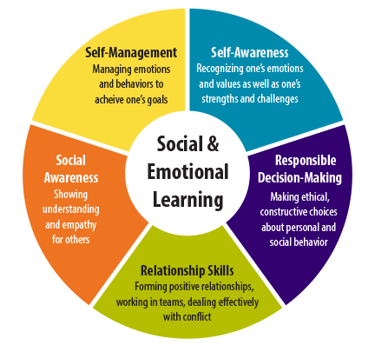
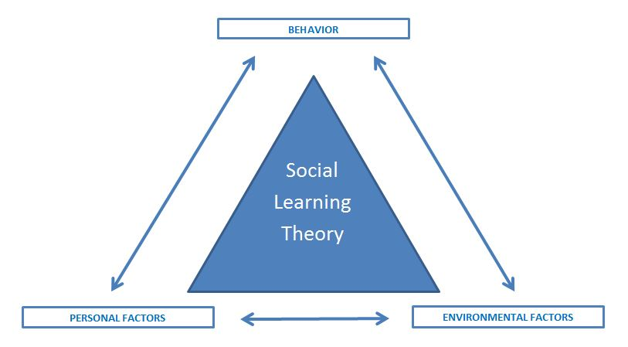
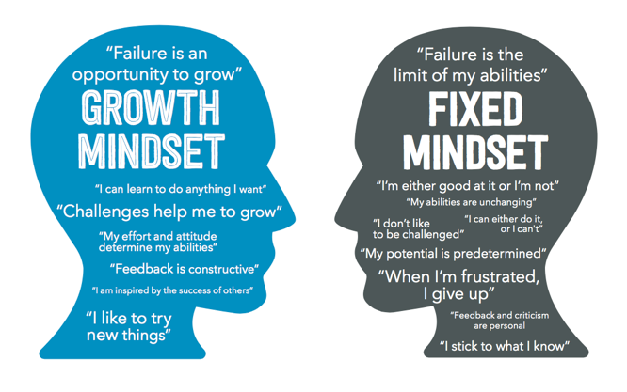
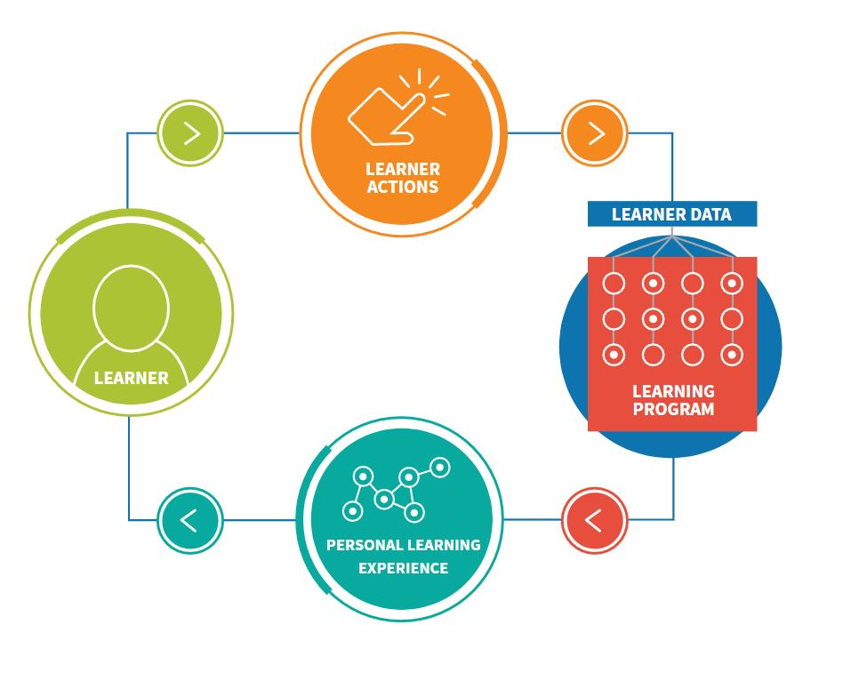
Curriculum to support Ready to Learn, encourages Learning to Learn, and prepares for the Skills to Learn
3
1
2
Ready to Learn
Learning to Learn
Skills to Learn
In order to be ready to learn, students need to feel safe and feel as if their basic needs are being met.
Online learners often come to us with health & emotional situations. Will develop Social & Emotional strategies to develop the 5 competencies of CASEL
A consistent, strong finding from the research is that successful online students are good at applying self- management to their learning process.
Online learners need skills to plan/set goals, monitor performance, and reflect on their learning. Will develop Social Learning Theory strategies to cultivate these skills
In order to be ready for college and the world of work, learners need occupational-specific & discipline skills with personal and social capabilities.
Online learners need skills and a Growth Mindset that thrives on challenge, sees failure as an opportunity to learn & grow, and to generalize skills to lifelong learning
These three pedagogical themes are prevalent across educational research & trends and will develop Social & emotional, Social Learning, and Growth Mindset strategies.
Adaptive learning is a technology trend that holds promise for all three pedagogical themes. Families come to Connections Academies to meet the unique needs of their children, today and tomorrow as lifelong learners. Connections Academies are well positioned to meet both these needs with a transformed curriculum.
20
Online & Blended Learning

