Slide 1
Dr. Chris McBride
Superintendent
Nevada Connections Academy

Slide 2
Introduction to Nevada Connections Academy
MATT WICKS
Director of Accountability
Expert State Frameworks Grades Schools
How 53% student mobility impacts Nevada state ranking
AGENDA
FAMILIES:
How Nevada Connections Academy Meets Child’s Academic Needs

Slide 3
SCHOOL
OVERVIEW
AUTHORIZED BY
Nevada State Public Charter School Authority
FOUNDED 2007
GRADES K–12
OPEN TO STUDENTS
Throughout Nevada
OFFICE IN Reno area
TUITION FREE Public School

Slide 4
STUDENT INFORMATION
Increased high school graduation rate:
2017: 45% grad 2018: 64% grad
STUDENT MOBILITY:
53.4% v. 23%
STUDENTS ON WAITLIST:
Enrollment cap: 3,571 Hundreds on wait list
Data on students who stay with NCA
Students enrolled continuously from 6th to 12th: 95% GRAD rate
Nevada School Climate/Social Emotional Learning:
Impact of positive social/emotional learning
NCA students ＞ State average
Cultural/Linguistic Competence
Relationships
Physical & emotional safety

Slide 5
PERSONALIZED INSTRUCTION, QUALITY TEACHING
Instruct, assess work, and grade
Experts at engaging students in online learning
Nevada-certified in grade and subjects
Bachelor’s degrees, master’s degrees, and beyond
Connected and available every school day via phone, WebMail, and live classroom interaction

Slide 6
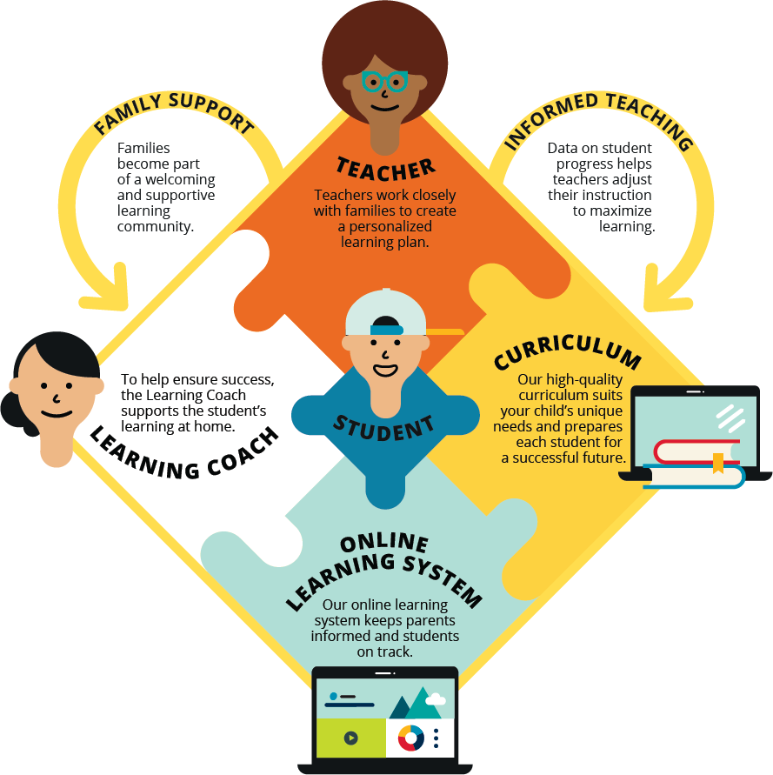

Slide 7
NCA’s AWARD-WINNING CURRICULUM
Enhances student achievement with flexible personalized pacing
“This school has been amazing! Allowing my child to strive for the best! They have a great curriculum and have shown that you are able to keep a good connection with the teachers, to see how much they care for all the children's education.”
‒ Julia M., from an NCA parent-driven petition
93% of parents agree that NCA’s curriculum is high quality
Results from 2019 Connections Academy Parent Satisfaction Survey

Slide 8
EQUIPPED FOR LEARNING
Materials from leading academic curriculum provider
Interactive multimedia tools bring concepts to life
“My 16-year-old will begin her third year at Nevada Connections Academy next fall. What a difference an all assistive technology school makes! I love that if we have a question, a teacher is just a phone call away. We love that the teachers take a genuine interest in my daughter and her education.”
‒ Cindy Chamberlain, NCA Facebook page
93% of parents say NCA’s technology improves their child’s learning experience
Results from 2019 Connections Academy Parent Satisfaction Survey

Slide 9
EXTRA ATTENTION SUPPORTS STUDENT SUCCESS
Personalized learning plan based on student needs
Support and encouragement in challenge areas
Ongoing assessments used to update plan
Reading and math remediation

Slide 10
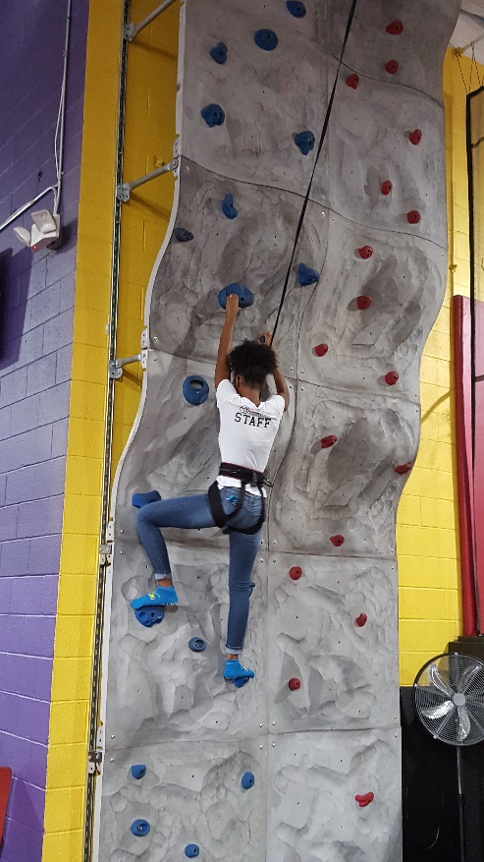
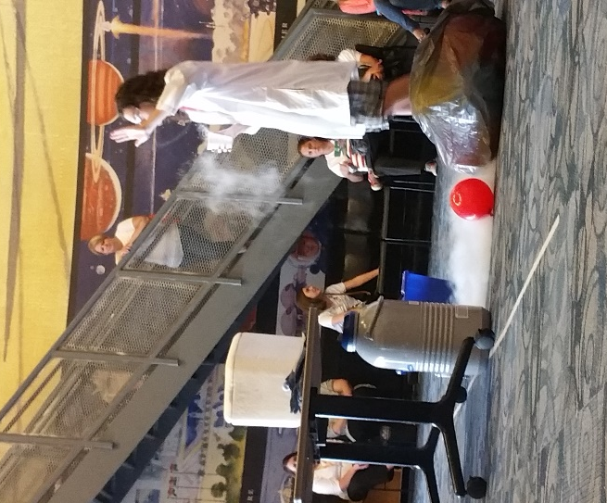
ENRICHING THE SCHOOL EXPERIENCE
Online clubs and activities
Volunteer, service, and leadership options
Family social events

Slide 11
THE PARENT’S ROLE
Parent or other trusted adult has the opportunity to act as a Learning Coach
Typically helps keep students motivated and on track
Encouraged to regularly communicate with teachers
Helps monitor attendance
Exhibits a strong commitment to student growth in all grades

Slide 12
ELEMENTARY SCHOOL EXPERIENCE
LEARNING COACH
STUDENT
TEACHER
Flexible schedule
Mostly offline work
15%–30% of the day spent on interactive online courses
One assigned teacher
Motivates students and personalizes lessons
Consults with Learning Coach regarding the student’s progress
Provides heavy daily oversight
Assists with lessons
Frequently consults with teacher and monitors grades
* Example Learning Coach activities only.

Slide 13
MIDDLE SCHOOL EXPERIENCE
LEARNING COACH
STUDENT
TEACHER
Supports transition to independent learning
Assists with some lessons
Monitors student grades and comprehension
Communicates with teachers and refers student to teachers when needed
Increased independence
Online and offline work
50%–75% of the day spent on interactive online courses
Subject-specialist teachers
Homeroom or advisory teacher monitors and assists with lessons
Consults with Learning Coach regarding the student’s progress
* Example Learning Coach activities only.

Slide 14
HIGH SCHOOL EXPERIENCE
LEARNING COACH
STUDENT
TEACHER
Mostly online work
More frequent LiveLesson® sessions
80%–90% of day spent on interactive online courses
May work with teacher to create modified schedule
Academic advising and guidance
Subject-specialist teachers
Advisory teacher continues to monitor advancement and helps develop a Personalized Learning Plan to help student prepare for the future
Consults with Learning Coach regarding the student’s progress
Encourages and supports student’s growing independence
Verifies lesson and assessment completion
Communicates with teachers and refers student to teachers when needed
* Example Learning Coach activities only.

Slide 15
THANK
YOU!

