Slide 1
2017-2018 Report

Slide 2
Mission Statement
To offer at-risk high school students the choice of an innovative and relevant education, which provides the flexibility and support to graduate from high school with concrete plans for their future.

Slide 3
BANV Student Demographics
Grade Level Distribution
2018-2019 (N=567) | 2017-2018 Total (N=629)
9th Grade - 10 (1.8%) | 9th Grade - 15 (3%)
10th Grade - 30 (5.3%) | 10th Grade - 67 (10%)
11th Grade - 147 (25.9%) | 11th Grade- 192 (30%)
12th Grade (2019) - 225 (39.7%) | 12th Grade (2018) – 246 (39%)
Adult - 151 (26.6%) | Adult - 113 (18%)
Female: 255 (45%) Male: 312 (55%) | Female: 298 (48.3%) Male: 331 (53.7%)

Slide 4
BANV Student Demographics Ethnicity
2018-2019 (N=567) | 2017-2018 Total (N=629)
Asian- 19 (3.4%) | Asian- 22 (3.6%)
Black/African American- 98 (17.3%) | Black/African American- 114 (18.5%)
Caucasian/White- 146 (25.8%) | Caucasian/White- 185 (29.9%)
Hispanic- 254 (44.8%) | Hispanic- 263 (42.6%)
American Indian/Alaska Native- 5 (.9%) | American Indian/Alaska Native- 5 (0.8%)
Multiple Races- 34 (6%) | Multiple Races- 23 (3.7%)
Pacific Islander/Native Hawaiian- 11 (1.9%) | Pacific Islander/Native Hawaiian- 17 (2.8%)

Slide 5
BANV Student Demographics
Risk Factors: All Students
2018-2019 (N=567) | 2017-2018 Total (N=629)
ELL - 79 (13.9%) | ELL - 80 (12.7%)
IEP - 134 (23.6%) | IEP - 148 (23.5%)
FRL- 394 (69.5%) | FRL- 372 (59.1%)
NRS Credit Deficient - 370 (64.5%) (Beginning of Year) | NRS Credit Deficient - 313 (49.8%) (Beginning of Year)
McKinney Vento - 59 (10.4%) | McKinney Vento - 68 (10.8%)
Alt Ed - 500 (87.1) | Alt Ed - 473 (75.2%)

Slide 6
2017-2018 Student Performance Beacon Academy of NV
Alt Ed Framework

Slide 7
Alt Ed Population Shift
Alternative Education Qualifying Factors and High Need Populations
 | 2015-2016 (N=823) | 2016-2017 (n=591) | 2017-2018 (N=629) | 2018-2019 (N=567)
Credit Deficient | 17.1% | 21.2% | 49.8% | 64.5%
Adjudicated | 0.7% | 4.1% | 5.6% | 9.2%
Habitual Discipline | 1.9% | 5.3% | 6.8% | 8.3%
IEP | 12% | 18.1% | 23.2% | 23.6%
Multiple Qualifiers | 1.2% | 8.3% | 9.7% | 14.1%
Total | 25.3% | 44% | 75.1% | 87.1%
FRL | 49.5% | 53% | 59.1% | 69.6%
ELL | 0.5% | 5.9% | 12.7% | 14.2%

Slide 8
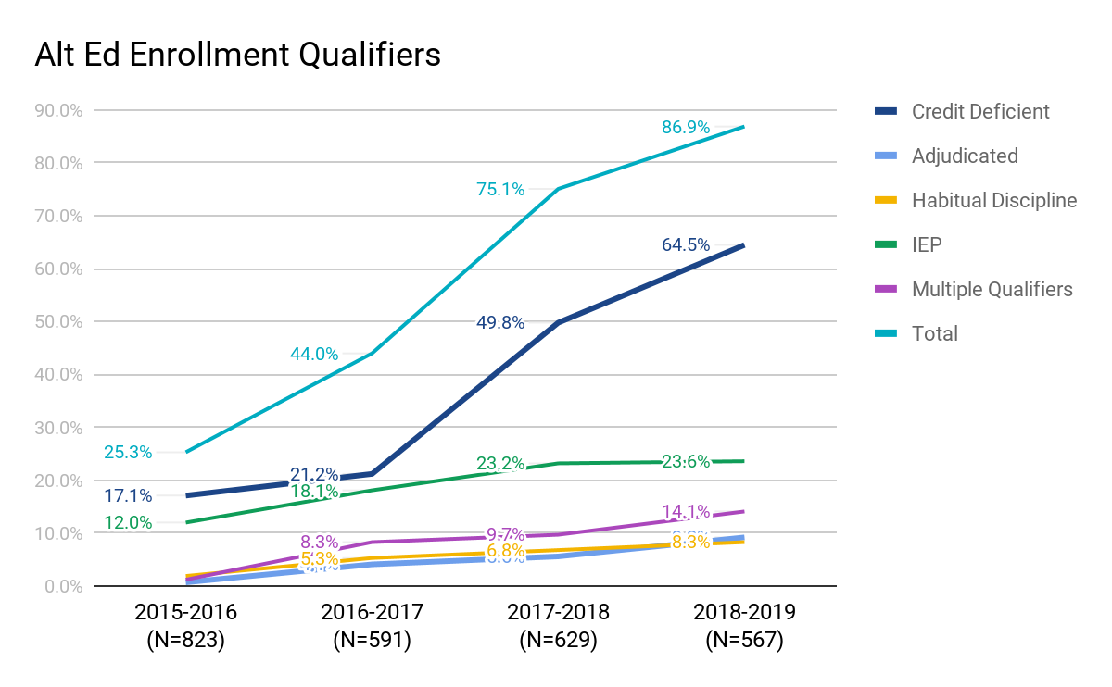
Alt Ed Population Shift

Slide 9
Growth Scores: 30%
Growth Scores: MAP Reading and Math Assessments
 | 2016-2017 Alt Ed Score N=161 | 2016-2017 Alt Ed Rating | 2017-2018 All Students Score N=377 | 2017-2018 All Students Rating | Difference
Average Percentile Reading | 39% | Unsatisfactory (2/6) | 61% | Exceeds (5/6) | +22%
Average Percentile Math | 55% | Adequate (4/6) | 43% | Approaches (3/6) | -12%

Slide 10
Status Scores: 20%
Status Scores: MAP Reading and Math Assessments
 | 2016-2017 Alt Ed Score | 2016-2017 Alt Ed Rating | 2017-2018 All Students Score | 2017-2018 All Students Rating | Difference
Reading Level | -8.7 | Critical (1/6) | 0.3 | Adequate (4/6) | +9
Math Level | -5.9 | Critical (1/6) | 0.8 | Adequate (4/6) | +6.7

Slide 11
College and Career Readiness: 40%
College and Career Readiness Scores
 | 2016-2017 Alt Ed Score | 2016-2017 Alt Ed Rating | 2017-2018 All Students Score | 2017-2018 All Students Rating | Difference
Credit Attainment | 55.9% | Approaches (3/6) | 60% | Adequate (4/6) | +4.1%
Transition Success | 93.6% | Exceptional (6/6) | 89.1% | Exceeds (5/6) | -4.5%
CCR Assessment Participation | 86.5% | Exceeds (5/6) | 92.9% | Exceeds (5/6) | +6.4%
4 Year Cohort | 28.8%* | N/A | 33.2%* | N/A | +4.4%

Slide 12
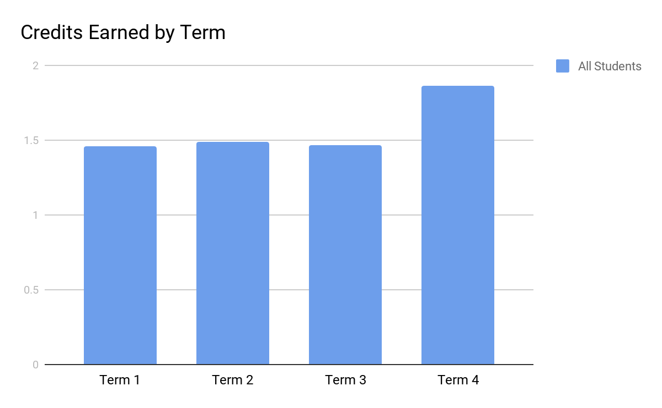
BANV Term Data
Average Credits Earned by Term
 | All Students
Term 1 | 1.46
Term 2 | 1.49
Term 3 | 1.47
Term 4 | 1.86

Slide 13
Cohort Graduation Rate
Class of 2018: Four Year Cohort
 | Total | % of Cohort Data | Grads | Non Grads | Grad Rate
Students Included in Cohort | 271 | 100% | 90 | 181 | 33.2%
Enrolled Before 2017-2018 | 142 | 52.4% | 79 | 63 | 55.6%
New in 2017-2018 School Year | 114 | 42.1% | 11 | 103 | 9.7%
Attended During 2017-2018 School Year | 215 | 79.3% | 76 | 139 | 35.3%
Began 2017-2018 with Fewer Than 11 Credits | 102 | 37.6% | 4 | 98 | 3.9%
Began 2017-2018 School with 11 or More Credits | 113 | 41.7% | 76 | 139 | 63.7%
New in 2018-2019 School Year | 15 | 5.5% | 0 | 15 | 0%

Slide 14
Non Graduates
Class of 2018: Non Graduates
 | Total | % of Non Grads
Non Graduates | 181 | 100%
Enrolled During or After Cohort Year | 118 | 65.2%
Enrolled During or After Cohort Year with 11 or Fewer Credits | 82 | 45.3%
Previously Dropped Out of Another School | 42 | 23.2%
Currently Enrolled for the 2018-2019 School Year (or graduated after October 1st) | 53 | 29.3%
Potential Five Year Cohort Grads | 35 | 19.3%

Slide 15
Cohort Graduation Rate
Class of 2018: High Need Populations
 | Total | % of Cohort Data | Grads | Non Grads | Grad Rate
Students Included in Cohort | 271 | 100% | 90 | 181 | 33.2%
FRL | 245 | 90.4% | 85 | 160 | 34.7%
IEP | 50 | 18.5% | 16 | 34 | 32%
ELL | 63 | 23.3% | 14 | 49 | 22.2%
McKinney Vento | 35 | 12.9% | 8 | 27 | 22.9%
Pregnant/Parenting | 23 | 8.5% | 5 | 18 | 21.7%

Slide 16
Cohort Graduation Rate
Class of 2018: Alt Ed Status Upon Enrollment
 | Total | % of Cohort Data | Grads | Non Grads | Grad Rate
Students Included in Cohort | 271 | 100% | 90 | 181 | 33.2%
Alt Ed | 179 | 66.1% | 30 | 153 | 16.8%
Non-Alt Ed | 92 | 33.9% | 60 | 28 | 65.2%
Notes:
.

Slide 17
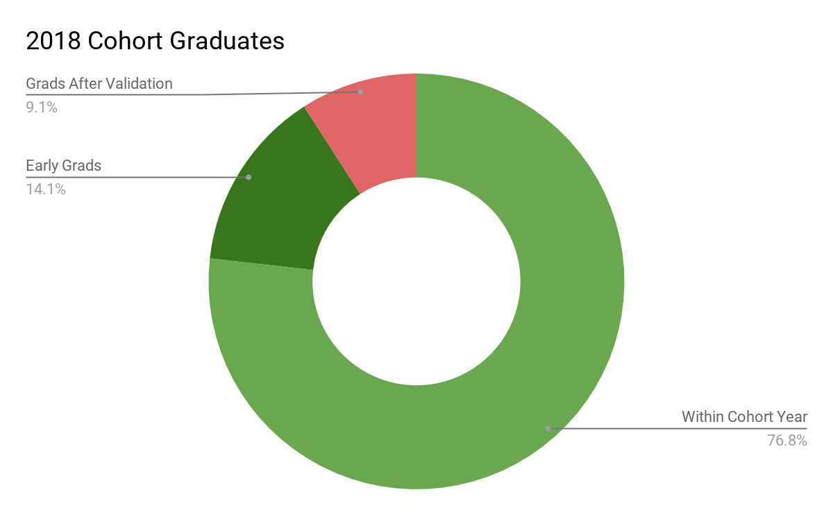
Cohort 2018 Graduates
Cohort Graduate Subpopulations
 | Total | % of Graduates
FRL | 84 | 93.3%
IEP | 16 | 17.8%
ELL | 14 | 15.6%
Alt Ed | 30 | 33.3%
All | 90 | 100%

Slide 18
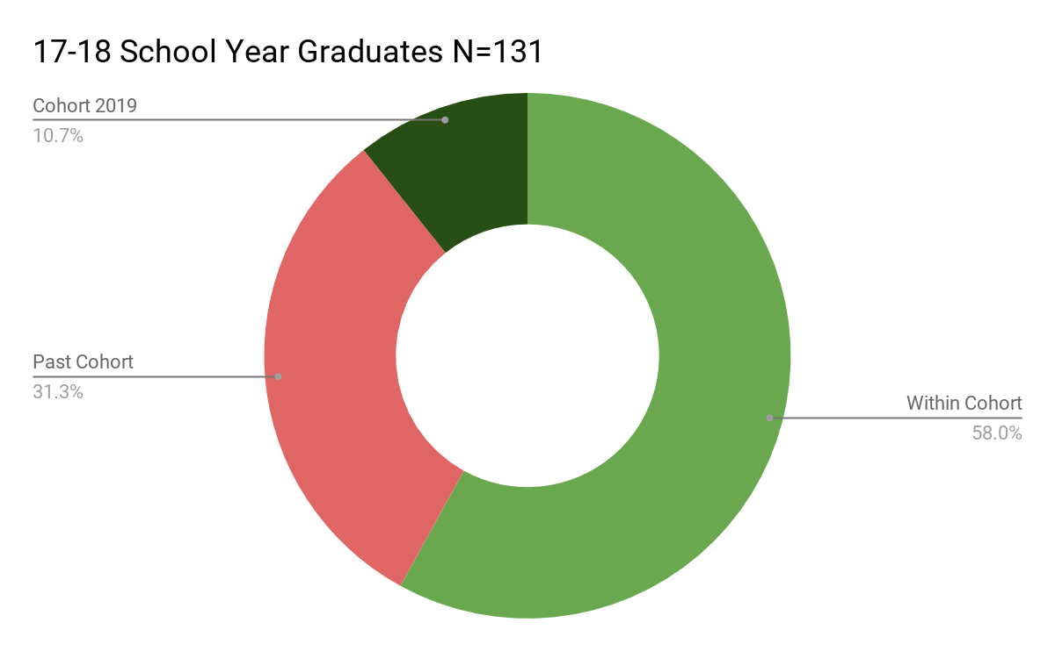
2017-2018 Graduates
Graduate Subpopulations
 | Total | % of Graduates
FRL | 92 | 70.2%
IEP | 19 | 14.5%
ELL | 24 | 18.3%
Alt Ed | 52 | 39.7%
All | 131 | 100%

Slide 19
Student Engagement: 10%
Student Engagement Scores
 | 2016-2017 Alt Ed Score | 2016-2017 Alt Ed Rating | 2017-2018 All Students Score | 2017-2018 All Students Rating | Difference
Attendance Rate | 93.7% | Exceeds (5/6) | 83.6%* | Unsatisfactory (2/6) | -10.1%
Retention Rate | 97.1% | Exceptional (6/6) | 80% | Approaches (3/6) | -17.1%
*attendance rates were calculated using two different methods due to a change in attendance tracking procedures; 2017-2018 figures are calculated using truancy in online classes

Slide 20
Overall Score
Assigned Points for Report Card Categories
 | Points Possible | 2016-2017 Alt Ed Points | 2017-2018 All Students Points | Difference
Growth | 30 | 11.6 | 18.4 | +6.8
Status | 20 | 0.5 | 12.5 | +12
College and Career Readiness | 40 | 25.8 | 29.5 | +3.7
Student Engagement | 10 | 9.1 | 6.1 | -3
Total Score | 100 | 47 | 66.5 | +19.5
Designation |  | Approaches (2/6) | Adequate (4/6) | +2/6

Slide 21
What Attributed to Gains?
Mission-Specific Programs and Interventions
Professional Development
Teacher Retention
Daily Short-term and Long-term Goal Setting
Mentor Program - one School Social Worker and one Teacher
Grade Report Tracker
Response to Intervention Facilitator - Math
Literacy and Data Facilitator
iLit
Low student to teacher ratio

Slide 22
Opportunities for Improvement
Dropout Prevention Program implemented Spring 2018, primary focus is Positive Behavioral Intervention Support (PBIS)
Dropout Prevention Facilitator and two additional School Social Workers
Check and Connect -Nationally recognized student engagement intervention model
Truancy Diversion Program with Eighth Judicial District Court in Clark County
School Campus Management Software for improved attendance and tracking
Incentives include RTC 30-day bus passes, hotspots, giftcards

Slide 23
College and Career Focus
The College and Career Advisor helps motivate students to earn their HS diploma by establishing realistic career/college goals and developing steps involved to reach these goals.
Creates opportunities for internships, apprenticeships, work experience
Utilizes Nevada Career Information System for college and career planning
Holds monthly workshops for students and their families
Recently formed a partnership with Help Southern Nevada to better assist students to realize their goals.

Slide 24
What’s Next?
Open second facility on East side of LV Valley
Continuous improvement
Questions?

