Slide 1
4 YEAR Adjusted Cohort Graduation Rate for the CLASS OF 2017-2018
January 18, 2019

Slide 2
OVERVIEW
I. Adjusted Cohort Graduation Rate Calculation
II. Previous Years Graduation Rates Comparison
III. SPCSA and State Comparison
IV. Class of 2017-2018 Graduation Rates
V. SPCSA Schools – Other Districts Comparison
VI. Subgroup Graduation Rates

Slide 3
graduation rate CALCULATION
Adjusted Cohort Graduation Rate (ACGR)
The ACGR was first collected for the 2010-2011 school year. To calculate the ACGR, states identify the “cohort” of first-time 9th graders in a particular school year, and adjust this number by adding any students who transfer into the cohort after 9th grade and subtracting any students who transfer out.
The ACGR is the percentage of the students in this cohort who graduate within four years.
States calculate the ACGR for individual schools, districts, charter schools sponsors and for the state as a whole using detailed data that track each student over time.
Graduation rate is calculated using the following formula:
(Number of graduates) / (Sum of graduates + Non graduates)
Graduation rate is included in NSPF for High Schools.
The maximum number of points possible for the NSPF Graduation Indicator is 30 points out of a 100.
NRS 388.330(e)

Slide 4
SPCSA GRADUATION RATES

Slide 5
Graduation rate comparison

Slide 6
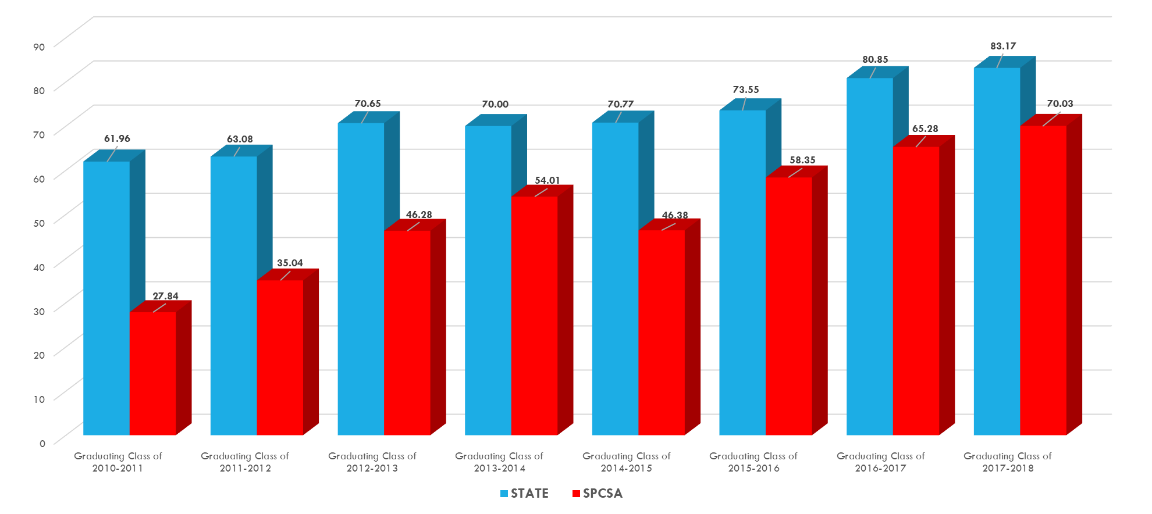
Graduation rate comparison

Slide 7
Graduation rate comparison
*http://www.doe.nv.gov/News__Media/Press_Releases/2018/Nevada_Posts_Highest_Graduation_Rate_Ever/
Note: Eureka County’s graduation rate was 100% in both 2017 and 2018.

Slide 8
Class of 2017-2018 Graduation Rates
Note: Beacon Academy of Nevada’s validated graduation rate for the class of 2017 – 2018 was 33.21%, but the school will have these results reported against the Alternative Performance Framework (APF) moving forward. Beacon Academy will provide more information and detail on their results in February.

Slide 9
Graduation rate comparison

Slide 10
Graduation rate comparison - STATEWIDE VIRTUAL SCHOOLS

Slide 11
Subgroup graduation rates

Slide 12
SUBGROUP COMPARISON – Class of 2016-17 vs. 2017-18

Slide 13
Questions

