Slide 2
What we know: Nevada ranks last in education
But did you know that Nevada also ranks towards the bottom in education funding?
Coincidence?

Slide 3
What values does Nevada place on its students?
Largest class sizes in US
Teachers: 3rd worst salaries in US when accounting for number of pupils / classroom
One of the most regressive funding formulas in US - latest “Is School Funding Fair?” report
Nevada gets a “D” in Education - The 2018 Quality Counts report
Nevada gets an “F” in education funding distribution and fiscal effort - The 2018 Quality Counts report.
NV school funding falls short by at least $4,000 per pupil - 2018 APA study

Slide 4
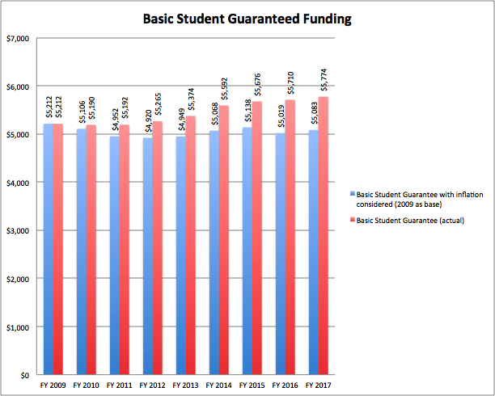
Funding has remained flat since 2009
(inflation adjusted)
Funding from the Nevada Plan, not earmarked programs

Slide 5
What hasn’t remained flat?
General Operating Costs
Transportation
Employee Raises
Employee benefits
Utility Costs
Books and technology resources
State and federal mandates and requirements on students, teachers, and districts
Funding adjusts by approx. 2 percent inflation.
Costs go up approx. 3-5 percent.
Costs > Funding

Slide 6
What is the result?
Overcrowding (growing classroom sizes)
Cuts to school maintenance
Unmet special education, ELL, and FRL needs
Forgone purchase of needed textbooks
Lacking career and technical education programs in rural schools
Cuts to school programs and resources
Limited programs for Gifted and Talented students
Morale poor

Slide 7
Unique Nevada Challenges
Second highest percentage of ELL students – 17%
Half of students on Free / Reduced Lunch
One fourth of students are transient.
Much of workforce employed in hospitality (parents working more shifts than U.S. average = unavailable after school and on weekends.)

Slide 8
Outdated Education Funding Formula
The Nevada Plan funding formula hasn’t been revised since inception in 1967.
Since then the state population and demographics have changed drastically.
Oldest education funding formula in the nation
The Nevada Plan
Doesn’t account for ELL, low-income, and gifted & talented students
Fails to adequately accommodate the dramatic changes in what is expected (mandates & standards) from students, schools, and districts
Doesn’t even adjust to cover actual cost increases.
NO RELATIONSHIP TO THE ACTUAL COST OF EDUCATING STUDENTS.

Slide 9
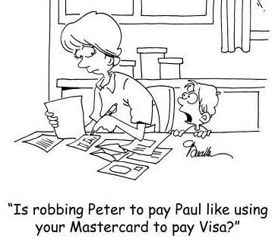
Shuffling of funds
Underfunded state and federal mandates = money shifted to cover mandates
Special education weights inadequate –covers less than half of what is necessary, = general fund dollars shuffled
Funding teacher raises = growing class sizes, funds shuffled from one critical resource to cover another

Slide 10
To make matters worse...
Room Tax
The Room Tax was diverted! Passed in 2009 to increase funds for teacher raises and student achievement, it was instead used to plug holes in the budget and never actually resulted in an education funding increase.
Since 2011, Nevada has diverted $1.2 billion meant for education increases.
Marijuana Tax
Marijuana tax revenue that was supposed to increase education funding so far never has.

Slide 11
The Shell Game
Even when tax dollars do go to education they don’t necessarily increase education funding.
When new tax dollars come in, the legislature can withhold other revenue sources leaving the amount of education funding the same.
The result? NO ACTUAL INCREASE
“Nevada’s K-12 system serves as one means by which the state budget for all purposes is balanced.” ⁻ Las Vegas Chamber of Commerce (2009).

Slide 12
Studies Sound Alarm Bells
Several studies commissioned by lawmakers have revealed many problems with school funding in Nevada.
Most recently, in 2018 Augenblick, Palaich, and Assoc. (APA) studied how much funding it would take to give students the opportunity to succeed.
APA talked to educators, administrators, and the community to get input
Examined the state standards and mandates, and evidenced based practices
APA found Nevada’s per pupil funding was $3,000 to $4,000 short (about half) of adequately funding our students, and even more funding was needed to meet the needs of low-income, English learner, and special education students.

Slide 13
Moving in the Right Direction
The 2017 legislature approved the continuation of some limited programs:
ZOOM Schools (ELL) - $142 million
Victory Schools (Low-income) - $80 million
Read By Grade 3 Grants - $44.5 million
Full Day Kindergarten - $170 million
College and Career Readiness Grants $63 million
SB 178 Resources for at-risk students - $72 million
Known as Categorical or Restricted-use funds

Slide 14
Challenges with restricted-use funds
Limited purpose. Often cannot be used to cover general operational expenses such as salaries, maintenance, transportation, etc.
Insufficient to cover all ELL, Special Ed or low-income students.
Unreliable. Must be reauthorized every biennium, thus cannot be relied on every year.
Vulnerable. They are vulnerable to a change in government leadership.
Limited scope. Often ignore needs of some schools/students. Disproportionately disadvantages rural schools.
Restricted-use programs are Band-aid programs

Slide 15
K-12 Affects Local Economy...
“Our ability to diversify Nevada’s economy is absolutely tied to the improvements we make in educational outcomes, student proficiencies, higher graduation rates and expansion of workforce training.”
- John Guedry, CEO, Bank of Nevada
Businesses shun Nevada because of its underfunded K-12 systems. Stating:
Uneducated and unqualified workers who are unable to meet the demands of private businesses.
A subpar public school system that employers don’t want to subject their children or their employees’ children to.
- LV Sun

Slide 16
…And Overall Well-being
High school dropouts:
2X as likely to be unemployed
3X as likely to receive welfare assistance
“Clear and strong correlation between the educational attainment of a state’s workforce and median wages in the state”. - Economic Policy Institute
Local economy: Every dollar spent on public schools in a community increases home values by $20 - National Bureau of Economic Research
Incarceration: 41% of all prisoners have not completed high school. Nationally, cost to incarcerate = ~$32,000 per year, v. the annual cost of a quality public education = ~$11,000.
Health: High school graduates have improved quality of health, with a 60% reduction in dependence on public health programs, and six times less likely to suffer from alcohol abuse

Slide 17
Our Students Deserve
A new education funding formula that
accounts for evolving demographic changes
appropriately funds the needs of every Nevada student.
Respect for the will of taxpayers and voters by using new revenue sources, such as the Marijuana Tax and Room Tax as intended to:
Increase public education funding
Refrain from filling budget holes in other areas.
Increased funds with accountability and transparency to ensure resources are used effectively.

Slide 18
What Can I Do?
Sign the FOFNV Pledge to increase funding, fix the formula and advocate for ALL Nevada students.
Join the coalition and help communicate message.
Contact your state legislator.
Educate your colleagues, friends, family and fellow parents.
>Organization a group and request a presentation from FOFNV
>Share graphics and articles on social media
>Share personal stories of education budget cuts that affect you
Facebook.com/fundourfuturenv @FundNVEd

Slide 19
“All students deserve appropriate resources to reach their full academic potential and graduate to be college and career ready.”
Learn more at www.fundourfuturenv.com
Contact: FundOurFutureNV@gmail.com
Michelle Booth – mbooth@educatenevadanow.com
Jenn Blackhurst – Jenn@hopefornevada.org

