Slide 1
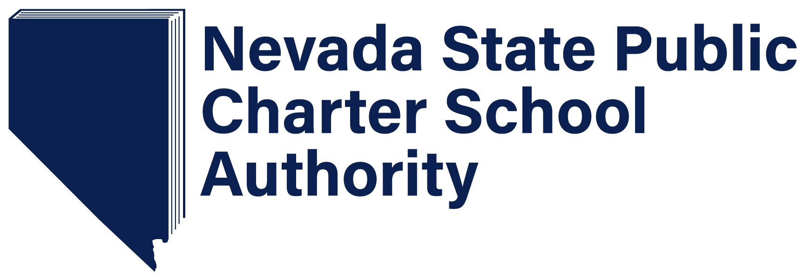
VALIDATION DAY DATA AND INFORMATION

Slide 2
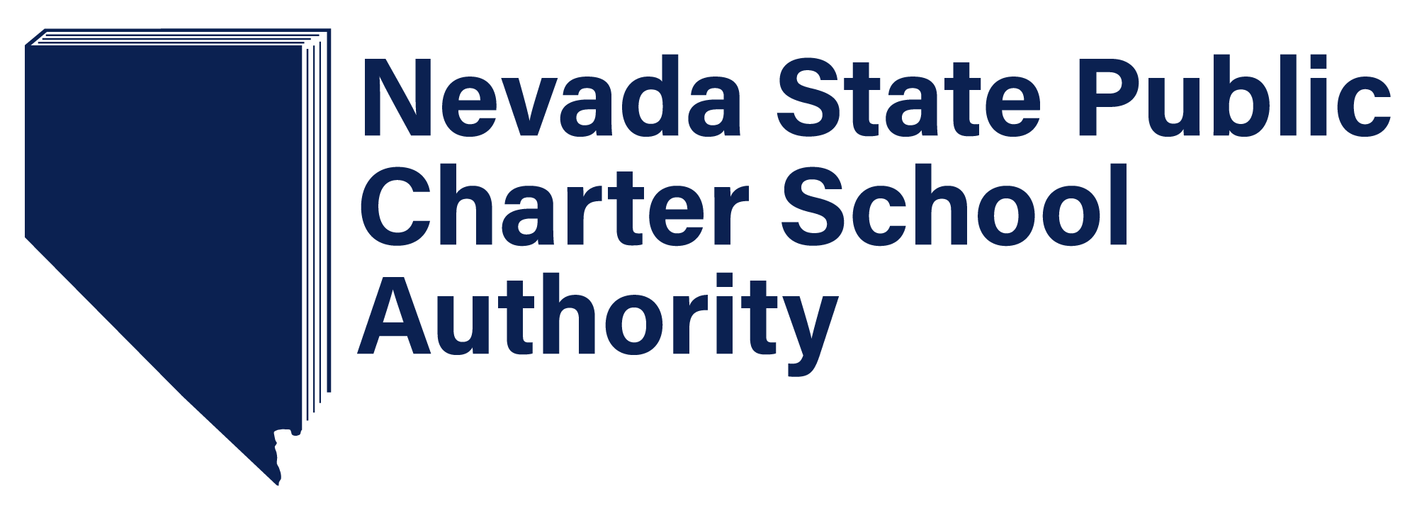
2018-19 SPCSA Enrollment Highlights
Validation Day: October 1st
Hispanic, Two or more races and Free & Reduced Lunch (FRL) populations increased
Caucasian population percentage decreased (44.1% to 40.1%)
Individualized Education Plan (IEP) and English Language Learner (ELL) enrollment numbers remained steady
FRL(14201 students, or 33.5%)
IEP (3792 students, or 9.0%)
ELL(2752 students, or 6.5%)

Slide 3
2018-19 SPCSA Enrollment Highlights
Female and male student population close to equal
50.4% female, 49.6% male
District of residence distribution:
Clark 91.7%
Washoe 4.4%
Other 3.8%
Enrollment by grade :

Slide 4
Notes:
14.4% increase from last year

Slide 5
Enrollment by Ethnicity

Slide 6
Enrollment Comparison SY1718 to SY1819

Slide 7
Enrollment Comparison SY1718 to SY1819
Notes:
This is chart shows the change in enrollment from last year to this year.

Slide 8
Proficiency Comparison for 2016-17 to 2017-18

Slide 9
Proficiency Comparison for 2016-17 to 2017-18

Slide 10
STATE vs. SPCSA

Slide 11
STATE vs. SPCSA

Slide 12
Comparison with All NV Schools

Slide 13
Comparison with All NV Schools

Slide 14
CLOSING REMARKS
Enrollment increased 5,333 students (14.4% increase overall enrollment from last year)
SPCSA schools are becoming more diverse
Hispanic, Two or more races and Free & Reduced Lunch (FRL) populations increased
Caucasian population decreased
FRL, IEP, and ELL enrollments still below the State average
Subgroup performance on the SBAC (state standardized test) improved in both Math and ELA

