Slide 1
Nevada Virtual Academy
Comprehensive Academic Improvement Plan Summary

Slide 2
NVVA Corrects Noted Deficiencies
NVVA provided demonstration of ongoing monitoring process and resultant improvements to implementation of cures
NVVA provided demonstration of how interim and benchmark assessments are used as tools to inform instruction as part of overall plan to reach schoolwide 3-Star rating
NVVA affirmed its benchmark targets and its commitment to maintain the school’s growth trajectory
NVVA provided evidence that its student and family support activities demonstrate positive student outcomes as measured by reduced chronic absenteeism, increased engagement, and more participation in teacher-led instruction
Notes:
Last month we demonstrated how our school corrected the Authority’s noted deficiencies.
Specifically, NVVA provided demonstration of ongoing monitoring process and the resultant improvements to implementation of cures. We shared data from programs like FAST that are showing how this year’s implementation is garnering desired results.
We demonstrated multiple uses of interim and benchmark assessments to inform instruction as part of the overall plan to reach a schoolwide 3 star rating.
We affirmed our benchmark targets and our commitment to maintaining our school’s growth trajectory.
Finally, we provided evidence that student and family supports are being effectively implemented and are yielding results in the areas of reduced chronic absenteeism, increased participation in teacher-led instruction, and improved engagement.

Slide 3
Cure: Instruction
Enhanced Instructional Model
Consistent utilization of Online School Curriculum
Teacher-led instruction to ensure full, comprehensive coverage of the standard
Differentiated Instruction
Teacher-led instruction at the student instructional level
Monitoring implementation through reviewing student-level data throughout the week and routine observations
Student participation has increased 650% in teacher-led instruction
Notes:
A review of specific cures starts with instructional improvements. When considering tactics to build upon and increase improvements in our elementary school program, my team and I reviewed several years of student level data. Because most of this team is new to NVVA, we had the benefit of examining data without attachment to previous programs. We took a completely unbiased view of the student level data from school and state assessments and various parent feedback tools.
The most important aspects of an effective school are curriculum and instruction. As we noted in the documents we prepared for you last month, the data demonstrates a need for consistent utilization of the comprehensive online school curriculum. We are carefully tracking student progress through courses and implementing teacher-led instruction and additional interventions in response to student performance in the courses. We are also using formative assessment information to guide teacher-led instruction, to guarantee instruction is delivered in a differentiated way – at the student’s instructional level. We are monitoring student level data throughout the week and conducting routine observations of teacher led instruction.
We have confidence in this year’s implementation of these tactics. Specifically, student participation in teacher-led sessions has increased by 650% because the sessions are targeted and relevant to students, and because the entire school staff is driving home the importance of effective teacher instruction. These are the type of implementation metrics we are reviewing on an ongoing basis.

Slide 4
Cure: Meeting Each Student’s Needs
Blended/Pathway Changes
Newly created guidelines which emphasize on-going support for students and instructional pathways that address students’ individual academic levels
Ongoing monitoring course progress and benchmark assessments to ensure correct placement and engagement
Response To Instruction (RTI)
Revised requirements, interventions, progress monitoring and supporting our most academically at-risk students
Notes:
We are also implementing a new approach to instructional pathways, driven by data. We are reviewing student data throughout the year to ensure students are on the appropriate pathway at any point in time. The different pathways include independent, virtual and blended, with increasing instructional supports between pathways. There are several data points factored into assignments of pathways, such as course progress, benchmark assessments and teacher observations.
Our Response to Intention program includes components of effective multi-tiered intervention and support programs, such as determining specific interventions based on regular progress monitoring.

Slide 5
Cure: Additional Student Supports Example: Summer Programming
Overall Goal: provide ongoing remediation and enrichment for our students
Primary focus is K-5 students identified based on MAP scores (targeting less than 40%) and academic progress
Students will be highly encouraged to attend the six-week remediation program
Secondary focus is offering academic enrichment
Curriculum used will be consistent with the school’s yearlong curriculum (OLS) staffed by most effective licensed K-5 teachers as measured by student growth
*In reference to page #7 of Agenda Item 5 Memo
Notes:
Our improvement plan included descriptions of several instructional student supports. Summer programming is an example. The overall goal of our instructional student supports is to provide ongoing remediation and enrichment for students. With respect to summer programming, our primary focus is on students scoring in the bottom 40 percent on the MAP. Students will attend a six week remediation program led by our most effective K-5 teachers as measured by student growth, and utilizing the comprehensive online school curriculum. Academic enrichment is a secondary focus of the summer programming. We will assess students at the beginning and end of the summer programming to measure growth and identify the most effective components of the program.

Slide 6
Cure: Additional Student Supports Example: FAST (Family Academic Support Team)
Goal of FAST is to ensure students are engaged and making progress
74% of truant students in FAST this year were re-engaged and remain at NVVA.
ES students on a Back On Track (BOT) plan for 12 weeks increased academic growth by 37.5%
*In reference to page #5 of Agenda Item 5 Memo
Notes:
The Family Academic Support Team is an example of a non-instructional student support. The ultimate goal of FAST is to ensure students are engaged and making progress. Data related to these goals demonstrates the successful implementation of the FAST program during this school year. Specifically, 74 percent of truant students in the FAST program were re-engaged and remain enrolled in NVVA. Within the elementary school program, students who had a “back on track plan” as part of their FAST program saw a 37.5% increase in academic growth in a 12 week period associated with this plan.

Slide 7
Elementary SBAC Proficiency 2015/2016 vs. 2016/2017
NVVA more than doubled the improvement that the state made in Math and tripled the improvement the state made in ELA.
15/16
16/17
15/16
16/17
15/16
16/17
15/16
16/17
NVVA- 6.40% increase
STATE- 3.51% increase
NVVA- 2.40% increase
STATE- .83% increase
Notes:
We’re closing our summary with a review of student successes that demonstrate NVVA elementary program is improving. Our students’ improvement on state assessments is impressive and shows that this model works for hundreds of elementary school students. Specifically, NVVA students more than DOUBLED the improvement that the state made in math and TRIPLED the improvement the state made in ELA. It’s difficult to describe this level of improvement as persistently underperforming.

Slide 8
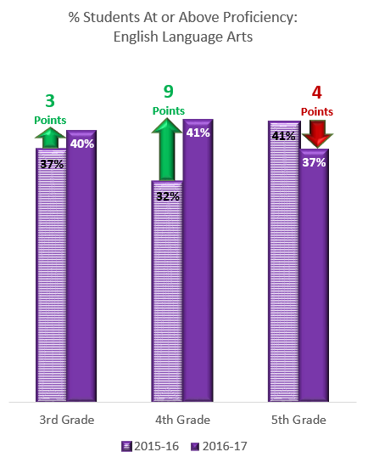
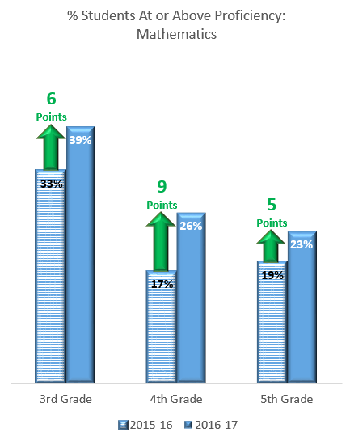
NVVA ES Program Showing Improvements
NVVA elementary school program is showing significant year-over-year improvements on state assessments in most grades and subjects.
Notes:
These improvement are significant year-over-year at the specific grade level in both math and ELA with one exception. While NVVA third graders saw a 3 point improvement in ELA, the state saw a 1 point decline. In fourth grade ELA, NVVA students increased by nine points, compared to a 1 point decline by the state. The one exception is NVVA 5th grade ELA, which saw a 4 point decline, compared to no change at the state level. NVVA third grade students improved by twice as many points as the state in math, and NVVA’s fourth grade students improved in math by THREE times as many points as the state. For fifth grade math, NVVA students improved by 5 points, compared to a 2 point improvement at the state level.

Slide 9
Average Student Growth Percentiles Broken down by years with NVVA
NVVA Elementary program is effective as demonstrated by increased growth persistence
4th Math
5th Math
 | Average SGP
3+ Years (n=40) | 44.9
1 Year (n=16) | 32.9
Percent Change | 36.5%
 | Average SGP
3+ Years (n=37) | 51.6
1 Year (n=42) | 38.5
Percent Change | 34.0%
4th ELA
5th ELA
 | Average SGP
3+ Years (n=40) | 47.8
1 Year (n=16) | 33
Percent Change | 44.8%
 | Average SGP
3+ Years (n=37) | 44.3
1 Year (n=43) | 31.2
Percent Change | 42%
Notes:
Finally, success is also evident in student progress made over years of attendance at NVVA. Student growth percentiles improve by between 34 and 45 percent when comparing students in their first year and their third year with our school. This significant growth is seen in both math and ELA, and in both 4th and 5th grade. There are no student growth percentile change data for third grade because students fake their first state test in grade three. Again, this growth pattern shows a school where hundreds of elementary students are excelling.

